Slide 1
Population Health Information Research Infrastructure (PHIRI)
27/10/2020 Assembly of Members 4
Name: Petronille Bogaert, Linda Abboud and Herman Van Oyen
Email: infact.coordination@sciensano.be

Slide 2
InfAct and COVID-19
Partners at the core of the Covid-19 response teams have indicated a strong need to structurally exchange between countries.
InfAct facilitates exchanges between partners and with international organizations
How?
  Rapid exchange with InfAct connecting experts and expertise
  Two weekly meetings with specific questions
  Storage of relevant information

Slide 3
InfAct and COVID-19
What?
  Exchange and provide overview of ongoing or planned Covid-19 studies
    What data should be collected to analysis impact COVID-19 on with NCDs?
  Exchange relevant regional, national and international data sources
    Which data sources are available at sub-regional level?
  Discuss and exchange on latest developments, recently validated tools, approaches, standard operating procedures, protocols and guidelines
    How are you counting COVID-19 deaths in your country and who is being tested?
    How are you carrying out contact tracing in your country?
  Exchange policy and impact measures
    Measure/guidelines about re-opening of schools and data indicating the consequences of the re-opening?
    How are hospital visits and visits to LTCF organized in your country?
    Impact on mental health through health surveys.
Notes:
Long term care facilities
Exchange and provide overview of ongoing or planned Covid-19 studies
What data should be collected to analysis impact COVID-19 on with NCDs? → who is hit hardest? Which chronic conditions to keep eye on?
Exchange relevant regional, national and international data sources
Which data sources are available at sub-regional level? → how to open up boarders?
Discuss and exchange on latest developments, recently validated tools, approaches, standard operating procedures, protocols and guidelines
How are you counting COVID-19 deaths in your country and who is being tested?
How are you carrying out contact tracing in your country?
Exchange policy and impact measures
Measure/guidelines about re-opening of schools and data indicating the consequences of the re-opening?
How are hospital visits and visits to LTCF organized in your country?
Impact on mental health through health surveys.

Slide 4
Conclusions
Many questions remain unanswered. Data gaps are persistent.
Partners are looking for mechanisms for structured exchange.
InfAct build up trust between the partners to share and exchange. InfAct provided a safe space.
➔ The need for a Research Infrastructure on population health is also reflected during the COVID-19 crisis for which DIPoH provides the basis.
Notes:
Countries needed counterparts for on the ground answers and exchanges between countries.
International were absent or not inline with the people in the MS.
MS to discuss with counterparts and discuss unofficial positions being honest and sharing concerns which was not possible in international forum.
Give the floor to Neville.

Slide 5
Population Health Information
Research Infrastructure (PHIRI) for COVID-19
Notes:
MoR provided support for this amendement of the RI programme. All the countries welcome to be on board. Low threshold to enter DIPoH on the long term. Safe taster.
PHIRI is a practical pilot of what DIPoH would offer.

Slide 6
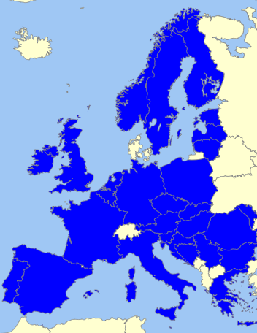
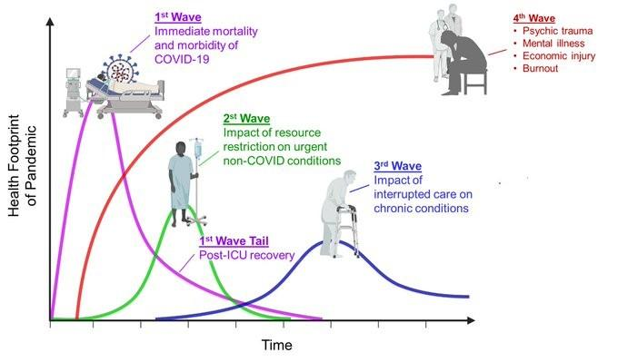
Overview
Name: Population Health Information Research Infrastructure (PHIRI)
  Timeline: 1 November 2020 – 3 years
  Financing: DG RTD – 4M€
  Coverage: 41 partners in 30 countries
  Structure: 9 workpackages and 3 transversal topics
Map with PHIRI Partners Source: http://philarcher.org/diary/2013/euromap/
The wider term impacts of COVID-19 Source: Twitter post 7:04 PM Mar 30, 2020 Dr. Victor Tseng
Notes:
20 public health or research institutes, 13 ministries, 3 universities and 4 others

Slide 7
PHIRI for Covid-19
Population Health Information Research Infrastructure (PHIRI) aims
  the identification, access, assessment and reuse for research,
  population health and non-health data in MSs and across MSs
  that can underpin public health policy decisions relevant to Covid-19.
In close interaction with key stakeholders in the health information landscape, in particular with ECDC, EUROSTAT, JRC, OECD, and WHO.
Notes:
How?
Platform with FAIR catalogues
Mirror groups operating in selected themes
Rapid exchange team
Foresight and mitigation team
Communication team against disinformation
What details:
A one-stop shop: PHIRI provides a FAIR data catalogue on health and health care data for structured information exchange. It facilitates access to and use of European data for research on the health of populations and on health care systems.
Investing in innovation in health information development for population health research: PHIRI supports health researchers to use Pan-European data in a distributed way, to link different data sources and to make their research FAIR and ELSI compliant.
Providing capacity building to promote interoperability and tackle health information inequalities: PHIRI provides support for management of population health and healthcare data starting from the phase of designing data collections to analysis, reporting and preservation. Training of the health research community involves both the data producers and data users.
Assisting the health research community in developing methods for knowledge translation research: PHIRI supports researchers in methodologies to provide relevant and evidence based data ready for use in decision-making processes by citizens, clinicians, public health practitioner’s, policy makers. This is the return of investment to society improving the health of the European citizens and increasing the efficiency of our health care systems.

Slide 8














Interactions
InfAct
HealthyCloud: Health Research and Innovation Cloud
EGI-ACE
TEHDAS: European Health Data Space
Notes:
Examples of RIs that are heavily financially supported by the European Commission
We are interacting with them.
HealthyCloud and EGI-ACE are proposals.
Pathogen information : genomic profiling
ENA Archive, Elixir, Federated European Genome-phenome Archive (FEGA)
Biobanks: e.g. virology, serology
BBMRI
Experimental: treatments and vaccine development
ECRIN (clinical trials research), EATRIS (translational medicine)
Big data analytics: geographical contextual factors - dynamics of epidemics - forecasting

Slide 9
PHIRI for Covid-19
Objectives?
To provide a Health Information portal for COVID-19 with FAIR catalogues on health and health care data for structured information exchange across European countries. To link different data sources and to use Pan-European data in a GDPR compliant, federated way.
To provide structured exchange between countries on COVID-19 best practices and expertise. It allows researchers to provide relevant and evidence based information ready for use in research, and decision-making processes.
To promote interoperability and tackle health information inequalities. PHIRI supports researchers and public health bodies to research queries related to COVID-19 and provides capacity building for management of COVID-19 relevant population health and healthcare data
Notes:
How?
Platform with FAIR catalogues
Mirror groups operating in selected themes
Rapid exchange team
Foresight and mitigation team
Communication team against disinformation
What details:
A one-stop shop: PHIRI provides a FAIR data catalogue on health and health care data for structured information exchange. It facilitates access to and use of European data for research on the health of populations and on health care systems.
Investing in innovation in health information development for population health research: PHIRI supports health researchers to use Pan-European data in a distributed way, to link different data sources and to make their research FAIR and ELSI compliant.
Providing capacity building to promote interoperability and tackle health information inequalities: PHIRI provides support for management of population health and healthcare data starting from the phase of designing data collections to analysis, reporting and preservation. Training of the health research community involves both the data producers and data users.
Assisting the health research community in developing methods for knowledge translation research: PHIRI supports researchers in methodologies to provide relevant and evidence based data ready for use in decision-making processes by citizens, clinicians, public health practitioner’s, policy makers. This is the return of investment to society improving the health of the European citizens and increasing the efficiency of our health care systems.

Slide 10
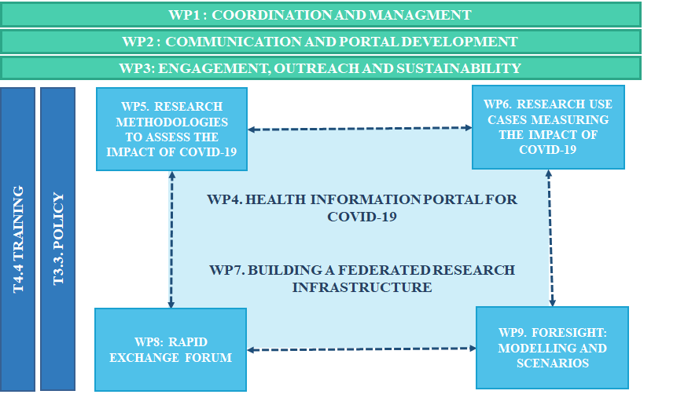
Figure 3.1. PHIRI work package interaction

Slide 11
Engage and involve
Addressing the COVID-19 infodemic (training, FAQ section, key messages)
Country visits to map state of play on monitoring the wider effects of COVID-19
Stakeholder meetings: 3 main meetings and short ones every two months.
  Overview of relevant COVID-19 activities

Slide 12
Health Information Portal
Health information portal
  Catalogue of population health data sources in countries
  Catalogue COVID-19 population health studies
  Catalogue on COVID-19 international guidelines, initiatives and projects
  Catalogue COVID-19 training material and courses
  Practices on COVID-19 ethical and legal aspects
Strengthening national nodes

Slide 13
Methodologies to asses impact of COVID-19
Indicators and methodologies used to assess the wider impact of COVID-19
Explore determinants of the severity of long-term health outcomes of SARS-COV-19
Efficacy of digital tools for contact tracing
Innovative tools for COVID-19 health monitoring

Slide 14
Four use cases
The use cases will demonstrate how a broad variety of secondary data (e.g. administrative and survey data) can be pooled and/or reused in a distributed way across Europe to produce actionable insights.
direct and indirect determinants of COVID-19 infection and outcomes in vulnerable population groups with reference to inequalities;
COVID-19 related delayed care in breast cancer patients;
the impact of COVID-19 on perinatal health and perinatal health inequalities;
COVID-19 related changes in population mental health,

Slide 15
Federated research infrastructure
Showing the potential of the infrastructure for a rapid cycle analysis using a demonstration pilot case
Pilot, developing an advanced version of the federated research infrastructure, including:
  the development of a common data model for a COVID19 rapid response;
  the design and deployment of the required data extraction, transformation and loading (ETL) processes; and,
  the implementation of the distributed analytical solutions, in particular the FAIR implementation of intermediate processes and final research outputs. This advanced version will mainly build on WP6 use cases.

Slide 16
Rapid exchange forum
1. To provide rapid response to research and policy questions that are raised in countries
2. To promptly disseminate internationally agreed guidelines, standards, reports and initiatives
3. To exchange (best) practices among countries regarding COVID-19
4. To provide a link with policy: the shifting landscape of evidence for policy

Slide 17
Foresight: Modelling and Scenario
The overall aim of this work package is to gain insights in possible future health impacts of the coronavirus outbreak, by developing scenarios for MS and associated countries’ national situation and draw lessons for the EU.
The objectives are:
  To get an overview of how European countries have been using foresight, modelling and preparedness regarding COVID-19 (mainly indirect infects)
  To develop and provide foresight capacity (levelling the knowledge needed for performing foresight, reducing information inequalities, strengthening European data uniformity)
  To support evidence-informed policy decisions, by exploring direct and indirect effects of COVID-19 on population health, on short and long-term, using scenarios and a broad conceptual model of health and care.

Slide 18
Capacity building
Infodemic
Burden of disease
Methodologies to monitor the wider impact of COVID-19
Capacity building and developers working group (IT implementation)
Building capacity in foresight

Slide 19
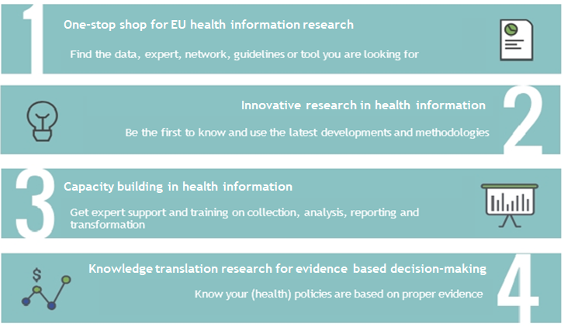
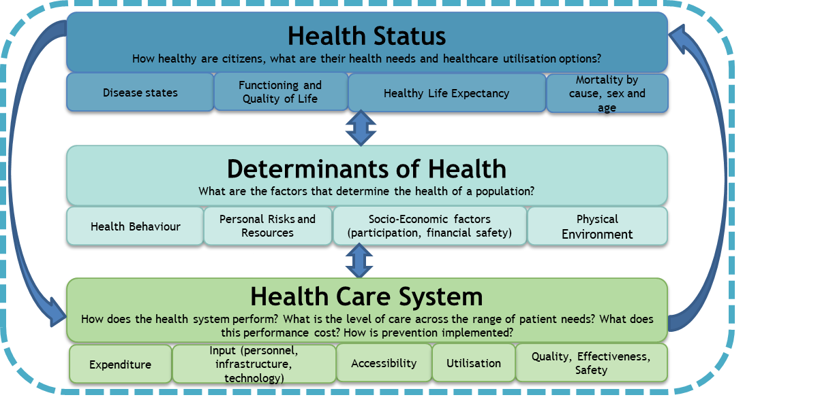
PHIRI relation to DIPoH
PHIRI building block of DIPoH mirroring services and actions
Same scope
Services
Organisational structure
Central Office
National Node
National Node
National Node
National Node
Research Network
Research Network
Research Network
Research Network
HI Portal
Services support

Slide 20
Next steps
DIPoH:
  Political support letters
  Next AoM at the end of April: legal structure
PHIRI:
  Stakeholder meetings
TEHDAS:
  Political Forums

Slide 21
Next steps
How would you like to be involved in the future?
What would you like to see addressed in the next meeting?

Slide 22
www.inf-act.eu
@JA_InfAct

Slide 23
Additional information

Slide 24
1. Vulnerable populations
Objective: to clarify the relationship between a wide variety of risk factors as exposures (e.g. NPI) and outcomes (infection, hospitalisation, death) and how this varies between settings and over time and is linked to the epidemiologic curve.
We will demonstrate how the distribution of infection, outcomes and risk factors using individual level health record, administrative and research data can be combined with ecological/group level contextual data across European populations to produce actionable policy insights.
One specific activity will be scoped in collaboration with the ECDC: the linkage between COVID-19 behavioural surveys across Europe and ECDC surveillance data to better understand the impact of changes of behaviour and the epidemic progress

Slide 25
2. Delayed care in cancer patients
Objective: Task 2 will seek to elicit
1) whether there has indeed been an increase in time to treatment in women diagnosed with breast cancer in the month previous to the lockdown measures, as compared with women diagnosed with breast cancer before that period; and,
2) whether this delay is a consequence of the intensity of the lockdown measures.

Slide 26
3. Maternal and newborn health
Objectives:
1) investigate the pandemic’s direct (infection by SARS-CoV-2) and indirect effects (related to health service accessibility and confinement) on perinatal health using routine population birth data;
2) assess whether effects differ by socioeconomic context;
3) use results to assess how policies in participating countries may have impacted health effects and social inequalities;
4) improve preparedness for future epidemics by creating a template for utilization of routine population birth data and identifying needed improvements to current systems.

Slide 27
4. Mental health
This case study will measure changes in population mental health associated with the COVID-19 pandemic.
We invite participating countries to identify available quantitative data collected retrospectively or performed to face the pandemic.
  Main sources could be surveillance systems, hospitals, mental health centers, mortality data, surveys, etc.
From databases selected, countries should measure the impact of COVID-19 on population mental health by analyzing data before and after the COVID-19 outbreak. The outputs will be available for integration into PHIRI.

Slide 28
WP7 federated research infrastructure
O7.3 Testing the solutions implemented in O7.2 for a final implementation of the federated research infrastructure.
O7.4 Figuring out upgrading options out of the lessons in other EU research infrastructures.
O7.5 Building an IT working group, both for capacity building on how to get the federated infrastructure implemented and for the actual development of the federated infrastructure.

Slide 29
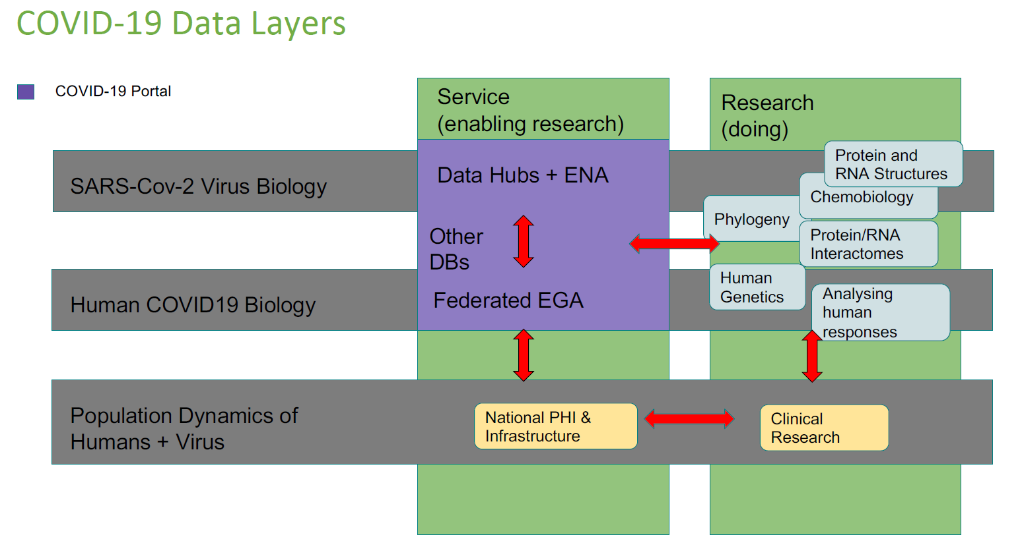
COVID-19 data platform
Genomic profiling

Slide 30
Added value PHIRI
➔ Population dynamics of human and virus: public health and societal impact
Health
Status
Disease states (risk factors)
Quality of life
Burden of disease
Vital statistics
Epidemiological data
Determinants of Health
Health behaviours
Personal risks and resources
Socio economic factors (inequality data)
Physical environment
Health Care System
Administrative data
Individual health records
Input and resources (personnel, infrastructure, technology)
Utilisation
Clinical research
Expenditure
Population dynamics
Notes:
What is in it for policy makers??
A comprehensive view on health data
Population health data (administrative data, age, gender, geographic, contacts, mobility, mental health, NCD risk factors)
Epidemiological (incidence case reporting, tested/positives, mortality, surveillance data link with TESSY/ECDC, epidemiological modelling)
Risk factors for outcomes: life style, immunology, genomic
Inequality data: stratification by socio-economic variables, health literacy
Data on social, economic, cultural and physical environment (including behavioural data, food, education, work environment, sickness leave/return to work, housing, school)
Data on health care services (promotion-prevention-cure and care) primary, secondary and tertiary care and elderly care
Clinical profiles, care level information (hospitalisations, ICU, respiratory support, severeness of symptoms, outcomes, hospital mortality, autopsies)
Individual health records (symptoms, contacts, consultation, treatments, outcomes, in and outpatient follow-up)
Resources: medical staff and healthcare workers
Telemedicine
Information on quarantine and asymptomatic patients
Data on MSs public health measures (diagnostic tools: PCR testing and serology testing, intervention measures, materials, logistics, hospital capacities, movement and location, protective gear, criteria for lockdown and exit strategies, contact tracing)

