Slide 1
DIPoH update-ESFRI application
27/10/2020 Assembly of Members 4
Name: Linda Abboud, Petronille Bogaert and Herman Van Oyen
Institution: Sciensano, Belgium
Contact: infact.coordination@sciensano.be

Slide 2
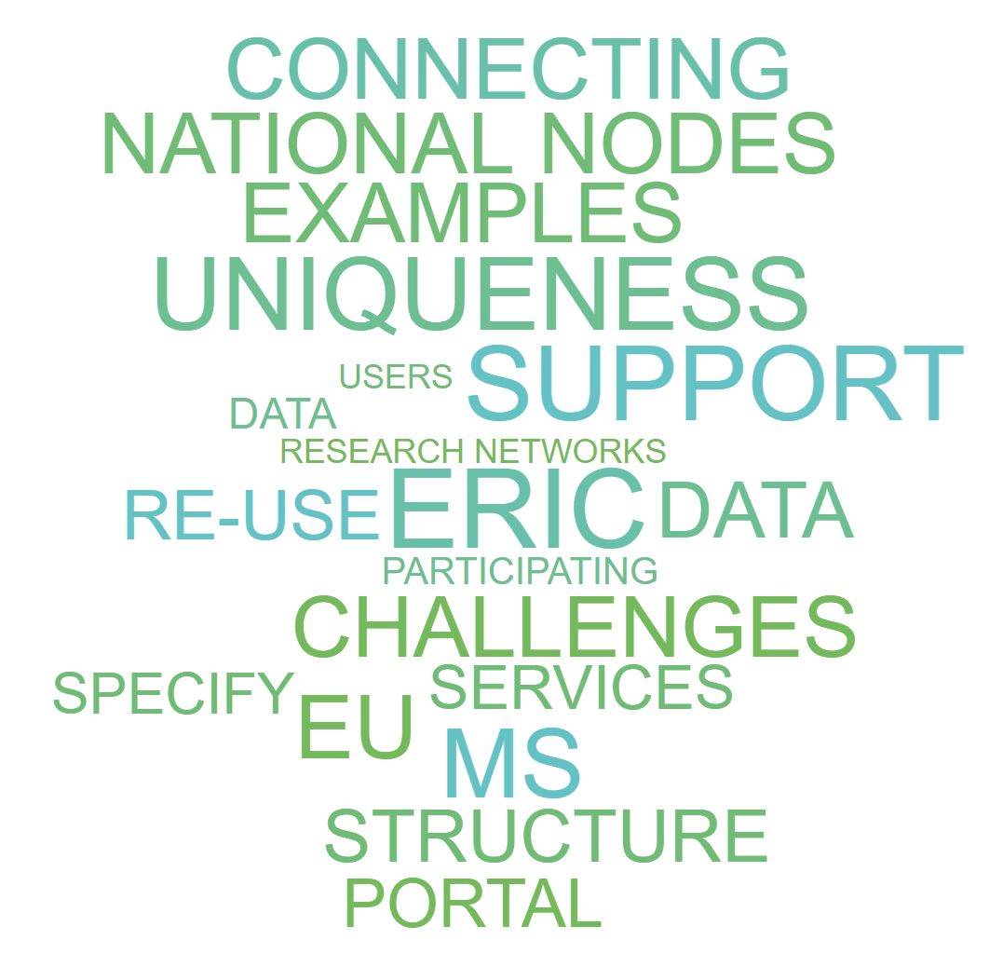
The road to DIPoH
Notes:
-Explain why we went for the ERIC and not other structure.
-Be more specific about the services the link who will carry them out and how?
-Explain structure of web-based platform
-Explain DSN and NN.
-Give more specific examples: type of data that is collected and products
-Number of institutions participating
-Explain that it is about data re-use not generation of new data.
-Explain we are not only continuing existing networks but connecting them for greater good and welcoming new ones. Services by RI are for any network.
-how the EU will be involved

Slide 3
The Challenges
FRAGMENTATION
Disperse knowledge
Incomplete data
Difficult access
INEQUALITIES
Differences in quality
Diversity in research capacity
PROJECT BASED
No long term planning
Waste of resources
Duplication
➔ Need for EU health information infrastructure
Notes:
Health information activities are often funded through ad hoc projects rather than through sustainable structures.
Much of the gathered evidence and knowledge is still dispersed, incomplete and difficult to access.
Large differences can be found in terms of quality and, as a consequence, in comparability of health information between and within EU Member States.
Large health information inequality both in term of data production, data platforms – clouds, data analysis and inference

Slide 4
Why a Research Infrastructure?
Allows responses to current needs and demands with high usability for Member States and EU institutions → focus efforts on priority aspects
Innovation in science and technology is vital to solving economic and societal challenges
Build bridges between research communities and with decision-makers
Facilitate innovation and knowledge-sharing
Can ensure continuity of existing health information activities
➔ Is the most feasible solution in the current setting
Notes:
Assessed different options:
Extending ECDC,

Slide 5
The Framework
Population Health

Slide 6
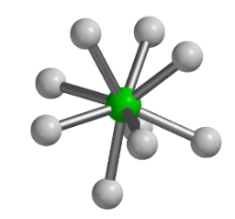
The Concept
DIPoH
Connect networks and stakeholders
Enable top level research
(linked data, access systems, processes and capabilities, …. )
Policy change
Practice change
Technology change
Improved health and other outcomes
Achievement of outcomes at lower costs
Notes:
Enable: to identify sources, access sources, assess quality of source and reuse/

Slide 7
Uniqueness of DIPoH
Covers the population as a whole (healthy and non healthy)
Facilitate secondary use of routine data sources
Include individual and aggregated level data
Does not include experimental research
Boost national population health research
Filling a Gap in the RI landscape
Health
of Populations

Slide 8
The Structure
Central Office
National Node
National Node
National Node
National Node
Research Network
Research Network
Research Network
National Nodes (NN) units within MSs representing national network,
Research Networks (RN) and their research communities,
A Central office and governance structure,
A Health Information (HI) portal as gateway to data, services and tools on population health
HI Portal
Services support
Notes:
We gave examples of the functioning and added value of bringing together NN and RN
And the web based portal specifications

Slide 9
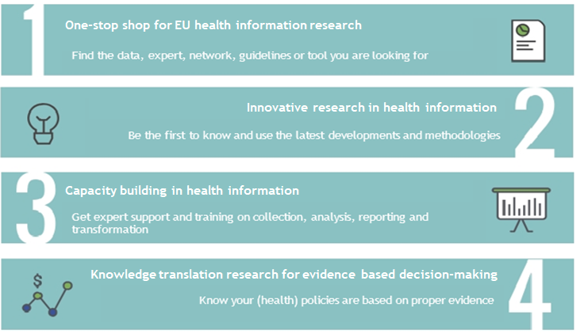
The Services of DIPoH

Slide 10
Why ESFRI
Stepwise and structured process to set up a European Research Infrastructure Consortium (ERIC) on Health Information
Stamp of scientific excellence, its Pan-European relevance, and the socio-economic impact
Opportunities for European funding
Engagement of MS and collaboration of research institutions at operational level

Slide 11
DIPoH progress

Slide 12
ESFRI
SUBMISSION OF PROPOSALS - 9 September 2020
HEARINGS - NOVEMBER - April-May 2021
ESFRI FORUM DECISION - June-September 2021
ESFRI ROADMAP LAUNCH - October-November 2021

Slide 13
DIPoH progress through ESFRI
Through the ESFRI application progress was made in further refining:
The need and expected impact
The landscape analysis
The user communities
The services
The structure and federated architecture
The management and governance models
The planning
The costs
Notes:
Within this progress we have also achieved a lot during the InfAct JA
Quantified users and services
If anyone interested to know more of any of these chapters- don’t hesitate to contact us

Slide 14
Maturity of DIPoH
BRIDGE Health and InfAct have contributed to various levels of the development of DIPoH
The Technology Readiness Levels (TRL)
TRL 1 – basic principles observed
TRL 2 – technology concept formulated
TRL 3 – experimental proof of concept
TRL 4 – technology validated in lab
TRL 5 – technology validated in relevant environment
TRL 6 – technology demonstrated in relevant environment
TRL 7 – system prototype demonstration in operational environment
TRL 8 – system complete and qualified
TRL 9 – actual system proven in operational environment
Notes:
We would like to highlight the aspects we have already achieved during the past years in the work towards DIPoH. By listing the progress and technology readiness levels we have achieved so far.
TRL (Technology Readiness Level) classification widely applied in EU research and innovation projects
This is based on the 4 services that are our core business
These are also summarized in the F&D report you have all received prior to the meeting.

Slide 15
I. One-stop-shop for EU health Information Research
Element |  | Achieved during BRIDGE Health and InfAct
One-stop-shop for EU health Information Research | Metadata catalogue of existing health information projects and networks | TRL2: A review of existing health information networks is conducted by InfAct and based on that formulation of metadata needs is prepared. TRL7: A prototype of the metadata catalogue of an initial set of network is being set up in InfAct and tested in operating environment (Health Information portal) (InfAct-WP5,7,8,9,10)
 | Metadata catalogue of existing health information data sources | TRL2: A review of types of data different health information networks and national health information systems host is conducted by InfAct and based on that formulation of metadata needs is prepared TRL7: A prototype of the metadata catalogue of data sources has been set up and tested in operating environment (portal prototype) (InfAct-WP4, 7,8)
 | ELSI and FAIR guidelines | TRL2: Several research networks have prepared their own ELSI and FAIR guidelines which have been summarised in previous project (BRIDGE Health) TRL7: ELSI and FAIR guidelines are demonstrated in the different settings and made available in the portal prototype (InfAct-WP10)

Slide 16
II. Innovative research in health information
Element |  | Achieved during BRIDGE Health and InfAct
Innovative research in health information | Leading-edge study designs and analytical methods | TRL4: Several proofs of concept have been / are being tested in controlled environments (BRIDGE Health and InfAct) TRL5: Machine-learning techniques has been applied to the administrative health databases to estimate the prevalence of diabetes type I/II and to predict the incidence of diabetes cases (InfAct-WP9), Methodological guidelines are in the preparation phase to use linked data and machine learning techniques for population health research with practical examples of research studies (WP9).
 | Semantic and technological interoperability across datasets (within and between countries) | TRL4: A review of existing research networks (BRIDGE Health) reveals that most of population health research has been conducted using rigid data schemas and centralised data infrastructures collecting aggregated information TRL3: Existing health data collection methods in EU by: i) reviewing and identifying standardized data collection methods and related quality assurance procedures; and ii) elaborating common procedures and guidelines for accessibility and availability of health information both for individual-based data and health indicators. TRL6: Use cases (InfAct-WP10) will demonstrate the feasibility of using common data models in distributed infrastructures implemented in real-life environments

Slide 17
III. Capacity building in health information
Element |  | Achieved during BRIDGE Health and InfAct
Capacity building in health information | Standardised protocols and guidelines exists | TRL2: the baselines for a European Capacity Building strategy: As a flexible structure of courses and other capacity building activities, modules and training plans, covering all the areas related to Health Information easily tailored to tackle the different needs and inequalities. (InfAct-WP6) TRL4: Several EU level health information networks have prepared standardised protocols and guidelines which have been used in different studies (summarised by BRIDGE Health) TRL5: Distribution of existing protocols and guidelines through portal prototype for larger audience (InfAct-WP5, 7, 8, 9, 10)
 | Static training materials | TRL3: Some EU level networks have prepared statics training materials (summarised by BRIDGE Health) E.g. Training material about BoD concept, methods and translation of BoD estimates into health policy is available on web-based platform (InfAct-WP9). TRL6: An online flagship course was designed and tested, addressing the following thematic areas: data analysis & interpretation, especially interoperability of data sources, derivation of European Core Health Indicators (ECHI) indicators and foresight/scenario analysis; transfer from data to policy, especially policy translation tools and data presentation. A database on training courses in health information is centrally hosted on web-based platform (InfAct-WP6)

Slide 18
III. Capacity building in health information
Element |  | Achieved during BRIDGE Health and InfAct
Capacity building in health information | Interactive training materials/ webinars | TRL1: A review of existing interactive training materials is prepared in InfAct TRL7: The online flagship course provides specific interactive training materials on data collection methods, sources of data, metrics and indicators, especially related to health examination surveys; and data privacy and ethical issues (the EU General Data Protection Regulation - GDPR).
 | A European level training programme for health information | TRL2: A review of existing training opportunities is conducted and a roadmap for future development is prepared in InfAct TRL7: A pilot of a flagship European health information training course has been carried out covering the fundamental aspects of health information (InfAct- WP6)
 | Assessment of Health Information System | TRL7: To strengthen the capacity in nine European countries, peer health information system assessments have been carried out. Guidelines have been developed on how to carry out a health information system assessment in peer review format. It also performs a mapping exercise to assess national health information systems and establishes an information base where stakeholders can contact international expert networks, projects and organisational bodies collecting comparable health data.

Slide 19
IV. Knowledge translation research for evidence based decision-making
Element |  | Achieved during BRIDGE Health and InfAct
Knowledge translation research for evidence based decision-making | Health Information impact index | TRL3: A review of existing tools and a prototype of the index has been developed within a post-doc project (BAHCI, H2020-MSCA-IF-2017, GA 795051), linked to InfAct
 | Integration of research outputs in national policies | TLR5: a) MS involvement through health and research authorities; b) integration of the InfAct’s outcomes into policies at regional, national and European level; c) strengthen national health information consortia involving health and research authorities through national nodes TRL6: The European health information training course provided a testbed for the use of knowledge translation research in health information (WP6)

Slide 20
IV. Knowledge translation research for evidence based decision-making
Element |  | Achieved during BRIDGE Health and InfAct
Knowledge translation research for evidence based decision-making | Innovation on health information for public health policy development | TRL5: Identifying inspiring examples from MSs with regards to innovation of data sources (i.e., use of data linkage and/or applying artificial intelligence) to estimate health indicators, which could be potentially useful to target priority public health actions and healthcare strategies. Development of best practices and guidelines to enlarge the set of morbidity indicators available across the EU using innovative techniques.
 | Piloting interoperability for public health policy | TRL2: Methods and techniques used to get sound knowledge out of data linkage, sharing, management and reporting

Slide 21
DIPoH phases planning

Slide 22
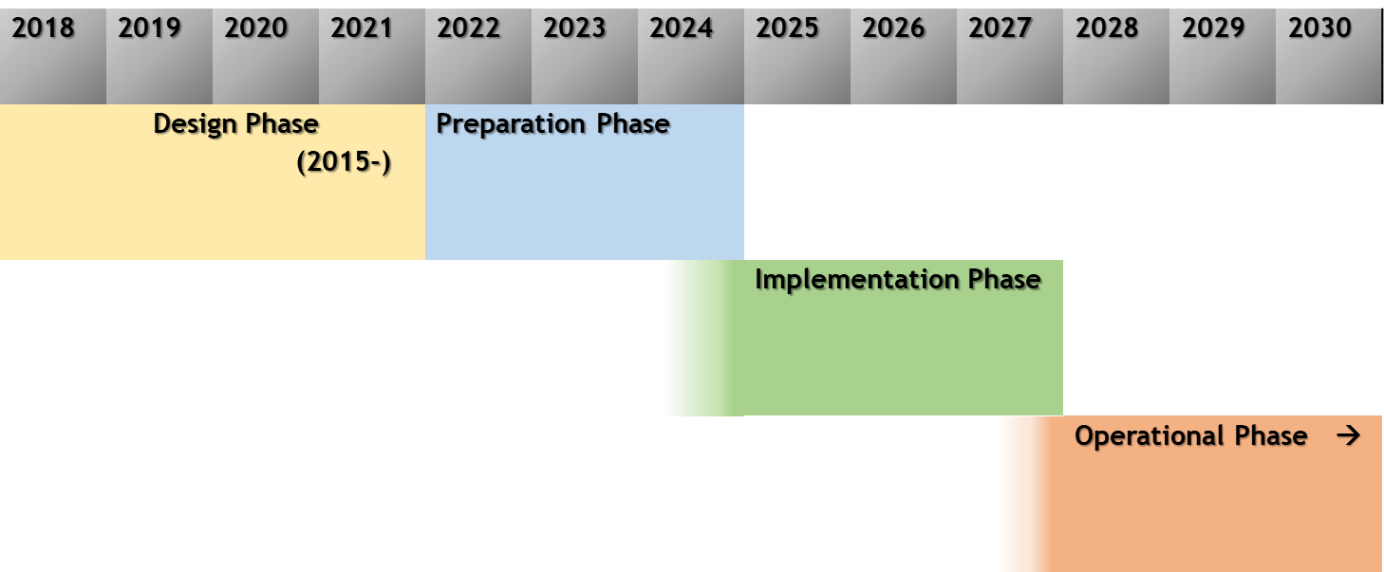
DIPoH phases
Notes:
Compiling results from BRIDGE and INFRACT into a design and feasibility report

Slide 23
I. Preparatory phase
The preparatory phase 2022-2024: prepare for the implementation and establishment of the legal entity.
Research development and technical construction: all the technical and scientific challenges are addressed.
Organizational agreements: all the socio-cultural challenges are addressed. A communication strategy is developed.
Central facilities specifications: all access challenges and specifications for the central office are addressed.

Slide 24
II. Implementation phase
(II) The implementation phase 2025-2027:
All aspects for the deployment of the legal entity of the operational RI are finalized.
The business plan and budget are agreed upon.
The deployment of the organisation and management structure is implemented.
The technical specifications of the e-infrastructure including the Health Information Portal are up and running

Slide 25
III. Operational phase
(III) DIPoH enters its operational phase (2028 onwards) once the legal entity and organisation management have been deployed and the RI is functioning and delivering services,.
DIPoH delivers its full range of services to its users.
Continue reaching out, collaborating and networking with new and upcoming RIs, international organisations and EU bodies.
Regular and annual reports are produced (research results, outreach, accounting, and progress).
Preparations for upgrade take place, or if not achievable, decommissioning actions are identified.
Notes:
ESFRI indicates a maximum of a 10 year operational phase. Thereafter DIPoH will strive for an update (2049).
In this phase, all institutional and political commitments for upgrading are obtained and a detailed plan is approved. Otherwise, DIPoH decommissioning process will take place in which mitigation activities are implemented, budget and liability identified and covered, and data management plan for decommissioning implemented and possibly including a takeover strategy.

Slide 26
DIPoH cost book

Slide 27
Cost estimations
The costs are estimated in accordance to ESFRI guidelines separating between initial investment costs (including design, preparatory and construction phases), and operational costs.
Costs estimations for general functioning and service development of Central Office and DIPoH’s Operational Elements (NN+RN).
➔ Human resources, travel and other costs (assets, utilities, etc)
Cost estimation for the technical resources for the set up of a distributed infrastructure
➔ To enable semantic and technological interoperability across NN and RN (as data hubs), with the Central Office

Slide 28
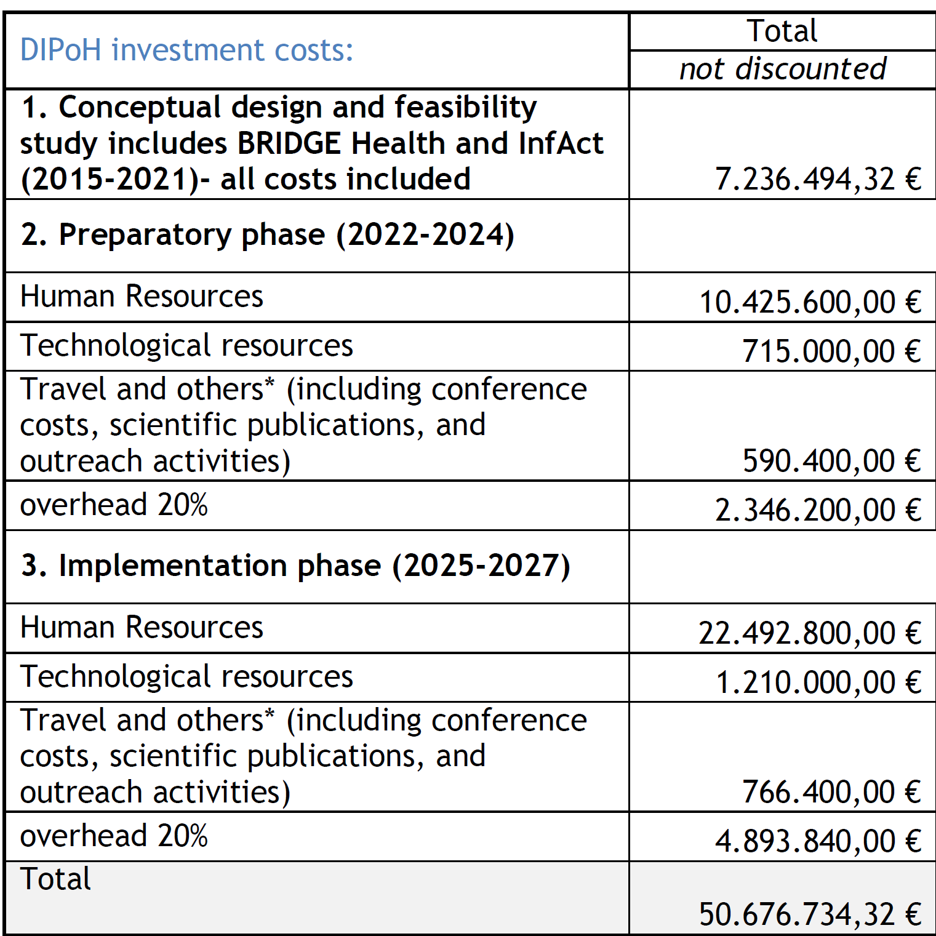
DIPoH total investment costs
The costs included in each phase are the sum of:
Human resources (for the central office, the National Nodes, the Research Networks),
Technological resource needed mainly for the setup of the e-infrastructure of DIPoH,
Travel and other costs, and,
Overheads.
Notes:
*In addition to travel, cost estimates are also considered for including yearly conference costs (50.000,00 €), scientific publications (25.000,00 €), and outreach activities (25.000,00 €). These are added to all the phases. The overhead is calculated as 20% of the total. This is considered to also include building and equipment costs for the Central Office of DIPoH.

Slide 29
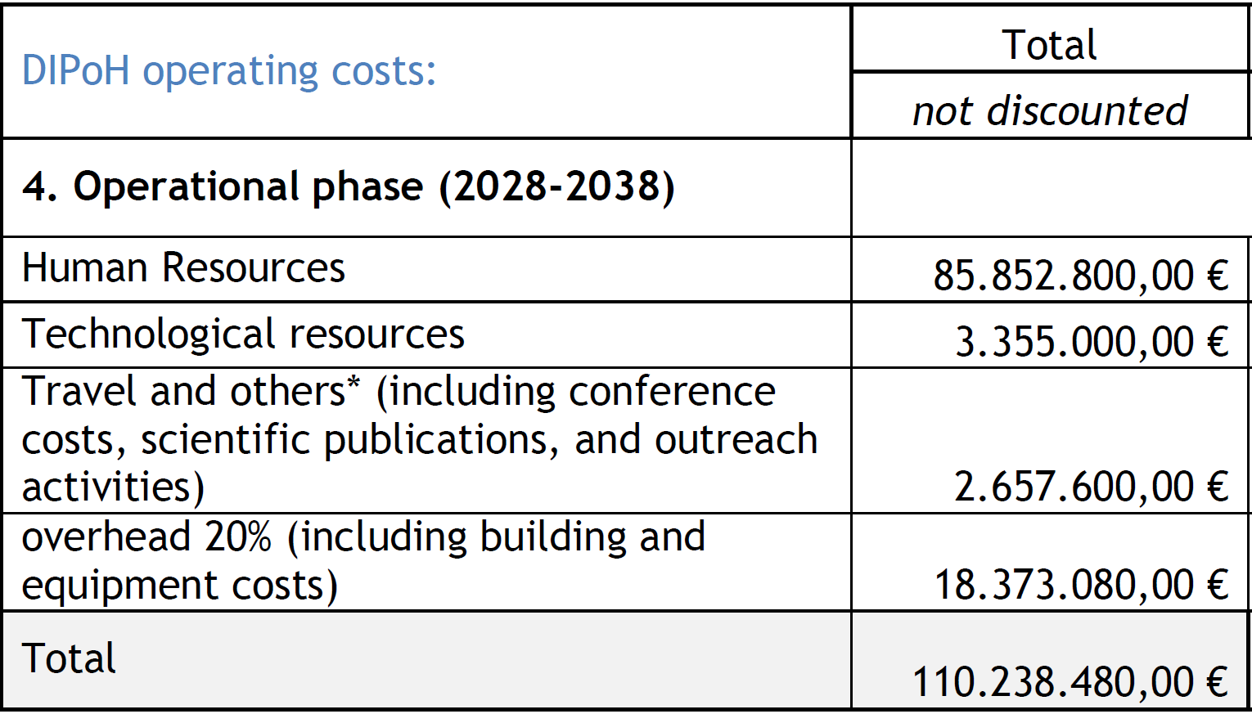
DIPoH operation costs
Yearly operating cost | 10.021.680,00 €

Slide 30
Summary cost estimations
Costs summary: | Euro (M€)
Design (BRIDGE Health, InfAct) | 7.6
Preparation (3 years) | 14.1
Implementation (3 years) | 29.4
Average annual operation | 10

Slide 31
Contribution model
As a distributed infrastructure, DIPoH will have a mixed funding model with the following contributions:
The Central Office is funded through membership fees paid by Member countries.
Fee for services paid by DIPoH users.
National Nodes are typically funded through national-level investments, supporting national coordination, the development and operation of services. International research funding also possible.
Research Networks are funded through national-level investments and international funding.
DIPoH collectively competes for grant funding from the EU under Horizon 2020 and Horizon Europe
Notes:
2. will depend on the final structure of committed partners and types of memberships (individual, network, organizations), which still needs to be decided during the preparatory and implementation phases of DIPoH.
Also the national own revenue for each specific country- specific benefit for the specific countries
Each specific country will benefit, the networks will take best practices in your countries
And specific country benefits from participating in the infrastructure.

Slide 32
DIPoH support

Slide 33
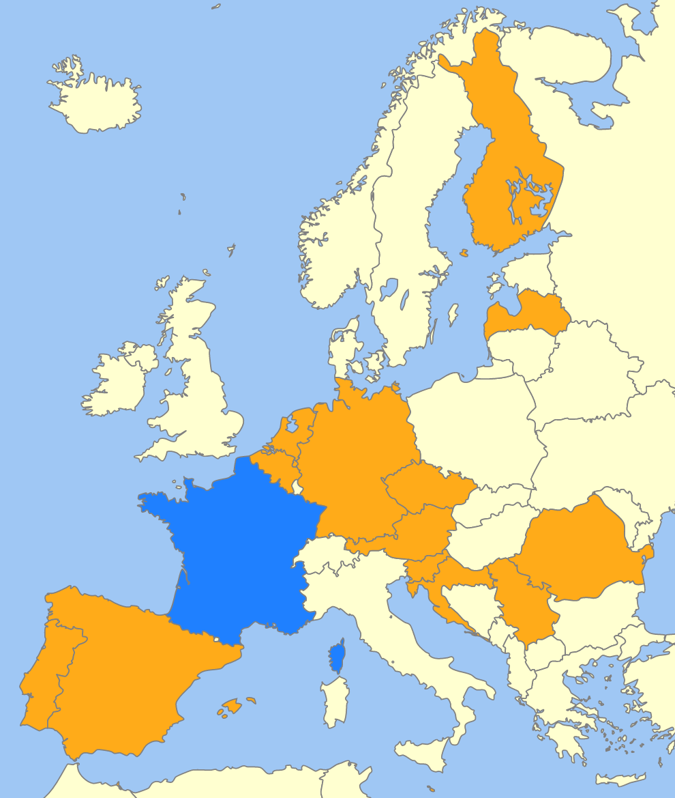
DIPoH support
Total of 14 countries have provided support for DIPoH by providing political support and/or signing MoUs
Notes:
Total of 14 countries have provided support for DIPoH by providing political support and/or signing MoUs
France is pending in signing the MoU

Slide 34
Research Networks
28
32
31
7
22
137
35
9
15
Notes:
8 research networks provided letters of support
Number of institutes/countries

Slide 35
Support for DIPoH is still welcomed
Including DIPoH on national roadmap
Provide political support
Provide financial support
Sign DIPoH MoU membership agreement
Please contact infact.coordination@sciensano.be
Notes:
How can we support you in adding DIPoH to national roadmap.

Slide 36
QUESTIONS?

Slide 37
www.inf-act.eu @JA_InfAct

Slide 38
The lead institute, Sciensano foresees to finance the coordination of the Central Office for the preparatory and implementation phases.
Notes:
825K euro for 5,5 years in kind of 2,5 FTE

