Slide 1
National Nodes and Research Networks in DIPoH
Assembly of Members, November 13th 2019
Hanna Tolonen, Finnish Institute for Health and Welfare (THL), Finland

Slide 2
DIPoH Structure
Central Office
National Node
National Node
National Node
National Node
Research Network
Research Network
Research Network
Research Network
National Nodes (NN) units within MSs representing national network,
Research Networks (RN) and their research communities,
A Central office and governance structure,
A Web based portal as a gateway to data, services and tools on population health.
Web Portal
Services support
Notes:
Central activities:
guide, support, monitor, evaluate project progress: scientific support for project development, reporting and reformulation; capacity building: estimated number of capacity building projects per year(3-6); health reporting: 5-10 four yearly policy reports by 5-10 research networks; two large EU-wide data collecting efforts per year; costs(rooms, lunches…)per project meeting; travel & substances; HI and data schooling/training programs; I-models; yearly conference health information.

Slide 3
National Nodes(NN)
Central Office
National Node
National Node
National Node
National Node
Research Network
Research Network
Research Network
Research Network
Functions as an organisational entity that liaises between the RI, the country and its Specific Research Networks and national health information stakeholders.
Oversees and supports the cohesion of the national health information system
by connecting with relevant national actors;
by exchanging national expertise at international level;
connect to ministries of health and research
Web Portal
Services support
Notes:
Here you can say that potential (depending on the country) the NPHIs can coordinate or facilitate as NN in countries

Slide 4
Aim of National Node
Bringing together the regional/national stakeholders that make it possible to:
Share expertise on regional/national level
Share ongoing activities on regional/national level
Update on initiatives, meetings and expert groups at EU level

Slide 5
National Nodes in the framework of InfAct
19 countries have reported their progress
Most countries (light blue) already have an existing format that bring together important HI stakeholders
In many countries, coordinating organization is National Public Health Institute
Some difficulties were reported to organise a NN meeting:
Identification of relevant stakeholders, attendance
Map by: http://philarcher.org/diary/2013/euromap/
Notes:
* Or presenting InfAct at an already existing meeting (2 out of the 7)
(16/05/2019
To note that all think it was beneficial!

Slide 6
Example of National Node: Finland
Key stakeholders for health information
Finnish Institute for Health and Welfare (THL), Statistics Finland, National Social Security Institution (KELA), Researcher groups in different Universities
No formal National Node but several joint activities of key stakeholders
TULANET: A collaboration forum of governmental research organizations
Meetings with the heads of THL, Statistics Finland and KELA in routine meetings related to use of data for both statistical and research purposes
New legislation ’the Act on Secondary Use of Health and Social Data (552/2019)’ will further facilitate information exchange

Slide 7
Social and Health Data Permit Authority Findata and the Act on the Secondary Use of Health and Social Data (552/2019)
Notes:
Findata will be operational in 2020 and starts operations in stages.

Slide 8
One-stop shop for the secondary use of social and health data
Grants data permits when data are requested from multiple registers
Provides the data in a secure IT-environment for data users
Help Desk for data users
Goals:
Enable effective and safe processing and access to data
Eliminate overlapping administrative burden
Enhance data protection and security
Improve register data quality

Slide 9
Primary and secondary use of personal data
Primary use
Services for a client or a patient
Secondary use
Scientific research
Statistics
Development and innovations
Teaching
Knowledge based management
Authorities’ steering, supervision, planning and reporting duties
Social and health data
National registers
Based on the Act on the Secondary Use of Health and Social Data (552/2019)

Slide 10
Person or organization in need of information
Previously:
Several applications
and permits
From 2020: One-stop shop
Application for permission to use data including data utilisation plan
Data owners
Findata
Data remains at Data Permit Authority
Grants data permits, collects, links and processes the data
Secure IT-environment
Data used via secured remote access
Help Desk

Slide 11
The Data
National Institute for
Health and Welfare (THL)
Population
Register Centre
(VRK)
Social Insurance Institution (Kela)
Statistics Finland
Cause of death
Cancer register
Infectious disease register
Hospital discharge register
National vaccination register
Medical birth register
Register of induced abortions
Register of congenital malformations
etc.
Population data
Families
Residence
Nationality
Prescriptions
National Supervisory Authority for Welfare and Health Valvira
Finnish Medicines Agency Fimea
Regional State
Admin. Agencies
(AVI)
Finnish Centre
for Pensions
(ETK)
Finnish Institute of Occupational Health
Social and health care operating units
Benefits and incomes
Diagnoses
Data saved in Kanta services
Occupational illness or exposure
Hospital district data pools

Slide 12
How to access data sets
Individual level data
Statistical level data
Direct identifying data removed
Available in a remote access environment for a set period
For purposes specified in the Act, excluding development and innovation
Free use for the purposes specified in the Act
A data utilisation plan is always required to access data sets
Notes:
Individual level data: anonymized or pseudonymized
Compliance with General Data Protection Regulation

Slide 13
Secondary use of data will benefit the entire society
Enabling legislation
Public health
National economy
Social and health service clients, citizens
Authorities steering social and health service activities
Social and health sector management
Social and health sector service providers
Social and health care
professionals
ICT companies
Startups
Research institutes and universities
Pharmaceutical companies
Development organisations

Slide 14
Trust is a must.
A secure remote use environment for individual level data sets
Data sets are only available without individual’s direct identifiers
Compliance with the Act will be supervised by the Data Protection Ombudsman, Valvira and Findata
Security in the operating environment will be controlled by an information security inspection body and Valvira

Slide 15
Operation to start stepwise from 1 November 2019
Will work together with data owners
A centralised system issuing data permits for collating social and health data from the registers of several controllers.
Will offer electronic tools for data permit applications, information requests and access to data.
Based on the Act on the Secondary Use of Health and Social Data (552/2019).

Slide 16
National Research Infrastructures in Finland
National RI roadmap updating in 2020.
Finnish Microdata Access Services (FMAS)
For routine data collections: Metadata & MyData (META), Joint permit service (PERMIT), Remote access system (REMOTE), Information and support service (INFO)
Population based surveys (FIRI-PBS)
For survey data: Standardized methods, metadata, common tools, data sharing, capacity building
Finnish Dietary Information and Research Infrastructure (FINDIRI)
Focus on dietary information database and related tools

Slide 17
Connection of National Nodes and Research Networks
Data providers and data users
Data sharing
Big data
Joint analysis
Knowledge and experts
Ethical and legal framework
GDPR
Helsinki Declaration

Slide 18
Research Networks(RN)
Central Office
Research Network
Research Network
Research Network
Research Network
National Node
National Node
National Node
National Node
Represent a group of collaborating experts that collect, exchange, harmonise and analyse data and information on a shared health topic.
Generate new data and research output, improve research methods and tools, develop standards and guidelines, and contribute to international research capacity building to support health policies and healthcare management.
Web Portal
Services support
Notes:
Research Networks:
IDB= injury data base
ECHI=The European Core Health Indicators initiative
ECHO=EUROPEAN COLLABORATIVE FOR HEALTHCARE OPTIMIZATION
EHES=European health examination survey
EuroPeristat=
EHLEIS= European Health & Life Expectancy Information System

Slide 19
Research Networks(RN)
Central Office
Research Network
Research Network
Research Network
Research Network
National Node
National Node
National Node
National Node
Examples:
ECHI-European Core Health Indicators
ECHO-European Collaborative For Healthcare Optimization
EHES-European health examination survey
EHLEIS-European Health & Life Expectancy Information System
EuroPeristat
EuSafe – Injury Database
Burden of disease
Web Portal
Services support

Slide 20
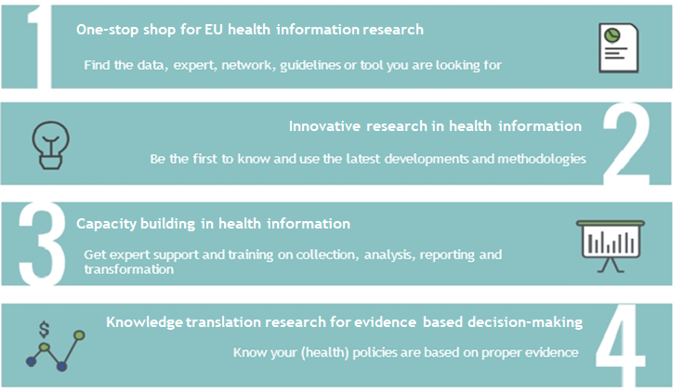
Services and tools by DIPoH

Slide 21
Research networks and expertise

Slide 22
Finland as an expert in Research Networks
ECHI - Coordinated activities under ECHIM in 2005-2013
EHES- Coordinated activities with EU funding in 2009-2012, after that coordination of network
EuroPeristat - Partner in the consortium
Burden of disease - Partner in burden-eu Cost Action

Slide 23
Data harmonization tools/protocols
How should I collect and code my data to ensure it is comparable with other countries?

Slide 24
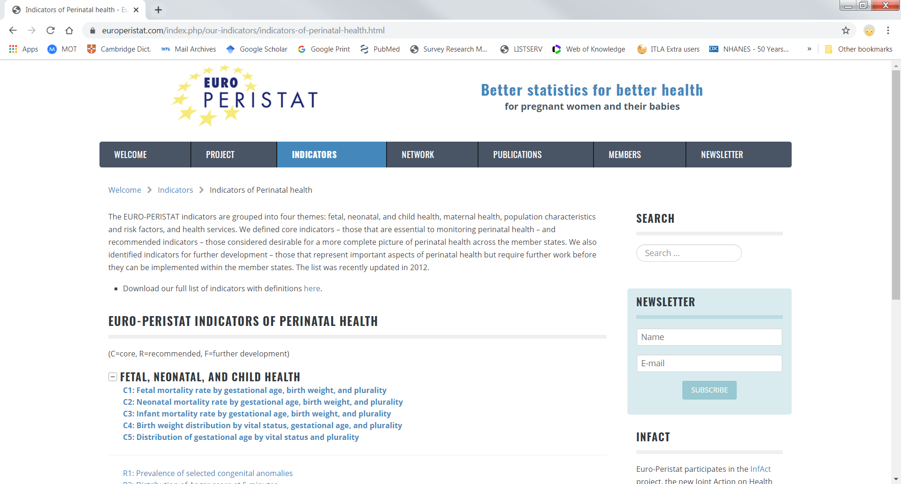
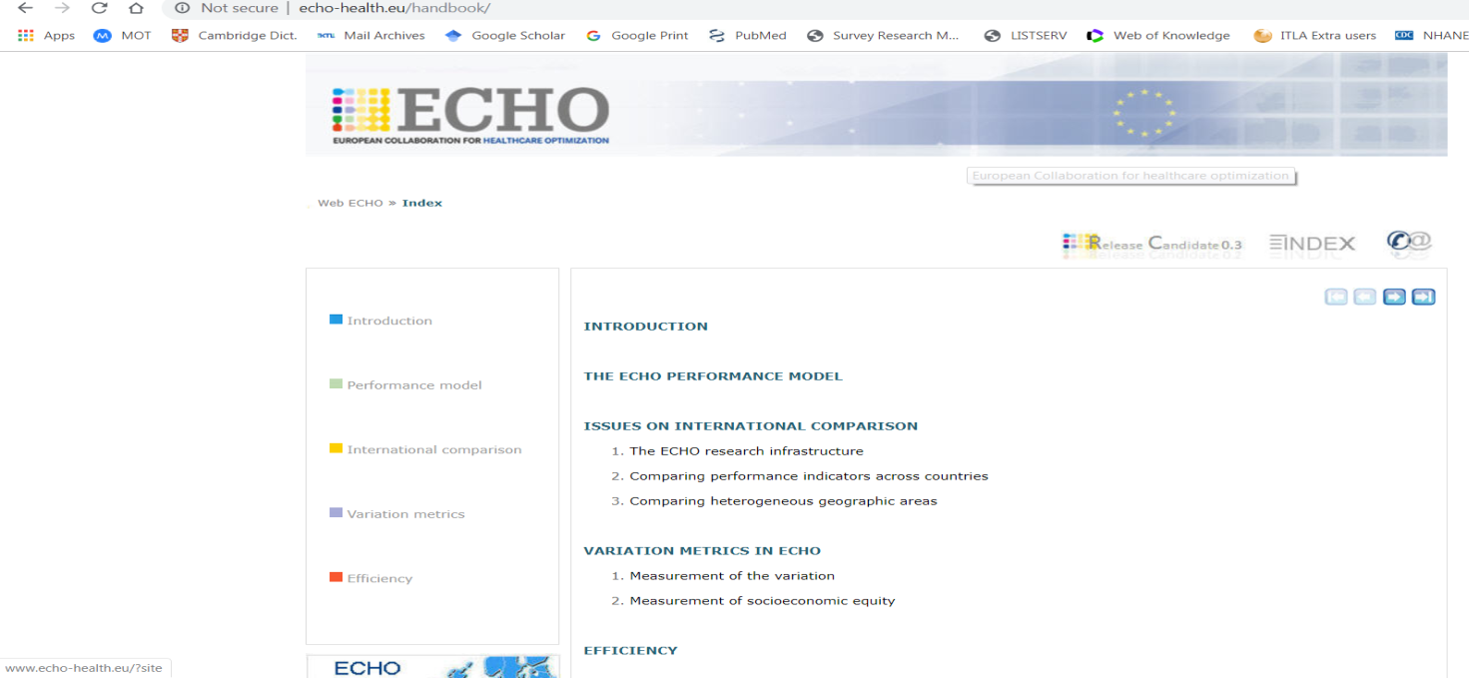
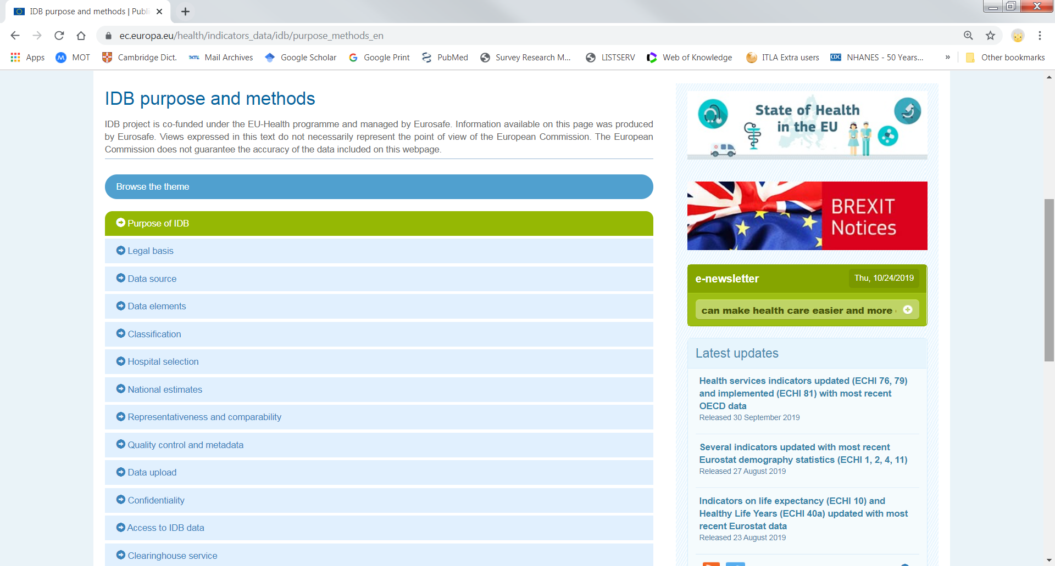
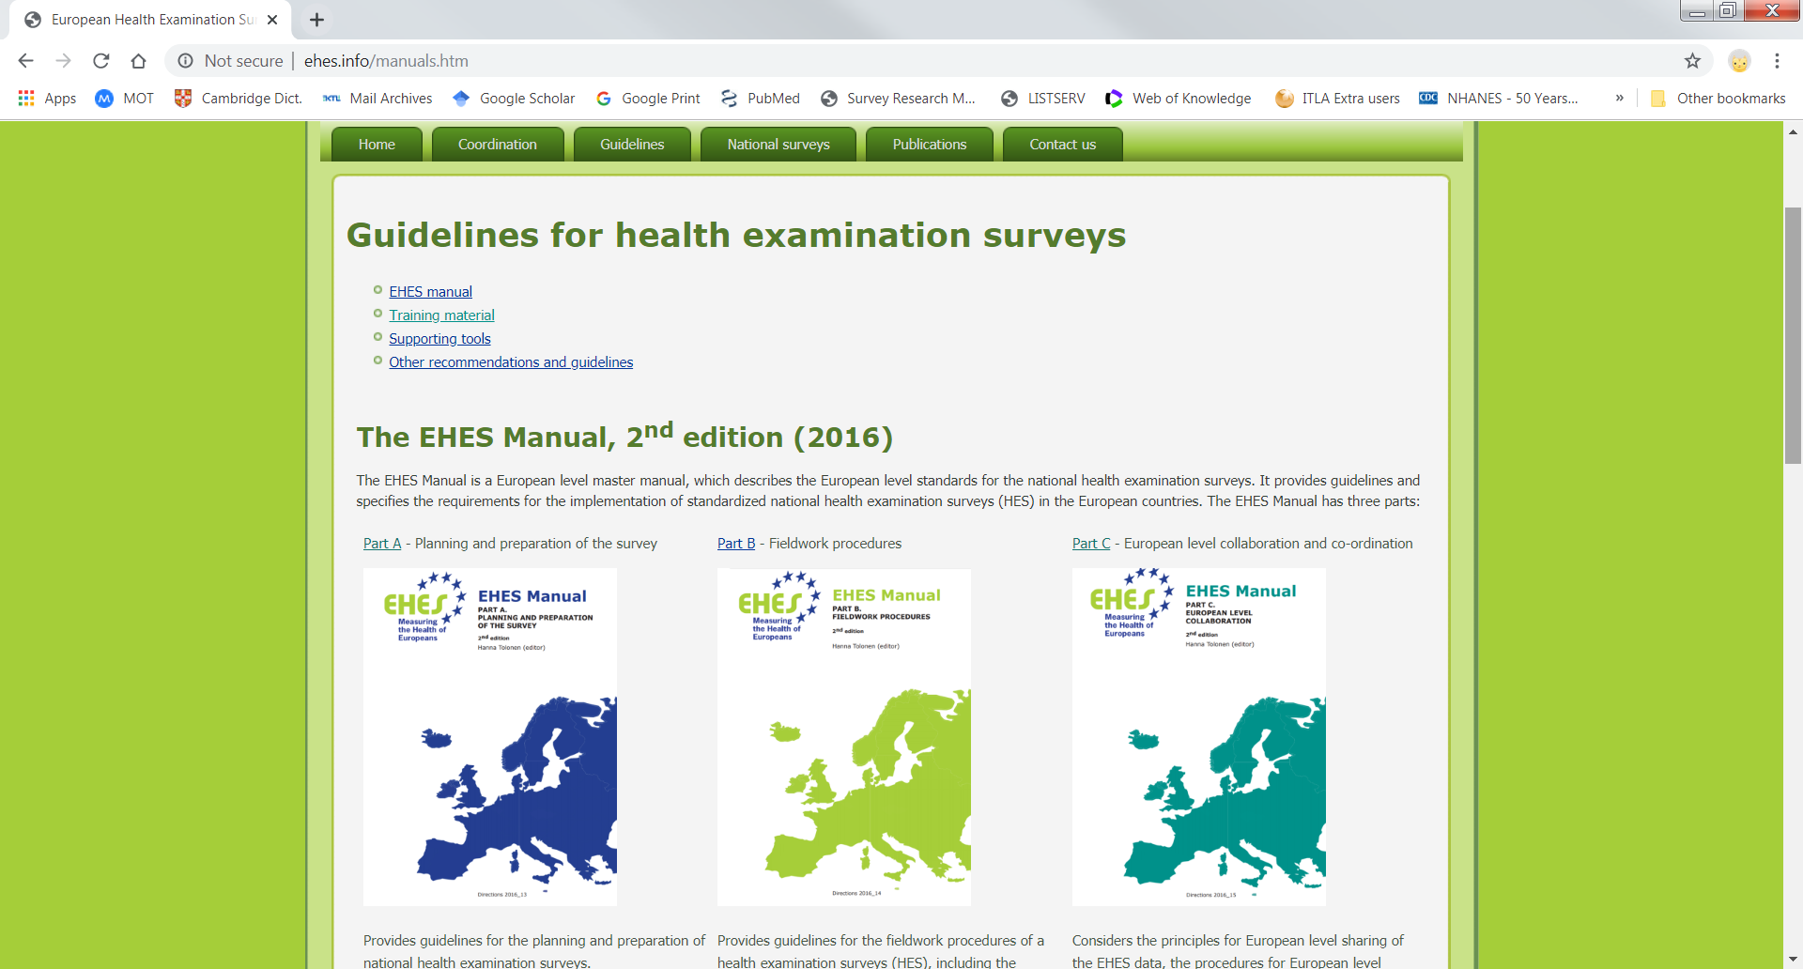
Data harmonization tools/protocols

Slide 25
Data harmonization tools/protocols
EHCI indicator definitions
ECHO handbook for methodological issues
EHES standardized measurement protocols and survey guidelines
EuroPeristat indicator definitions
EuroSafe IDB-manual and coding instructions
There are already a lot of tools and protocols, I just need to know where to find them.

Slide 26
Available data
Aggregated level data on different portals freely available
Individual level data under GDPR not freely available

Slide 27
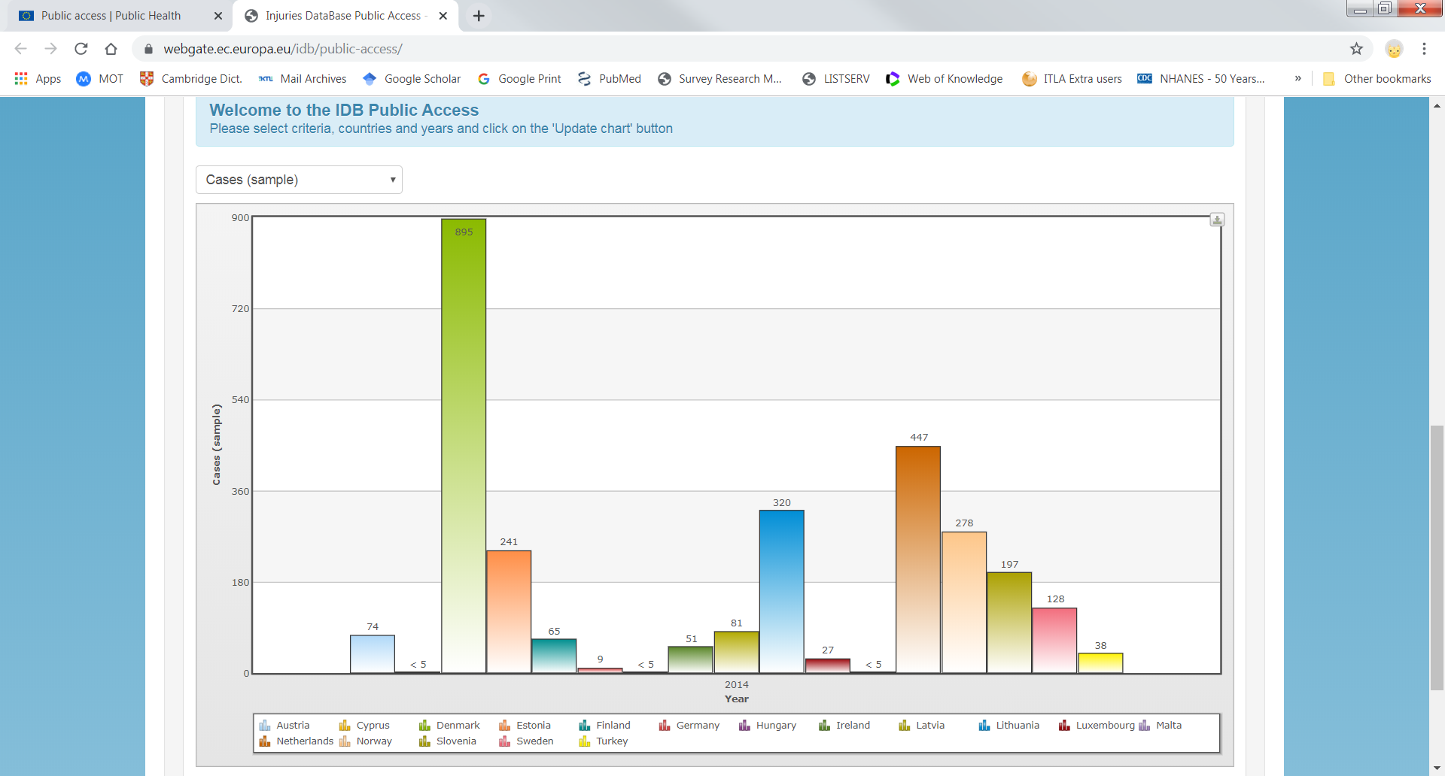
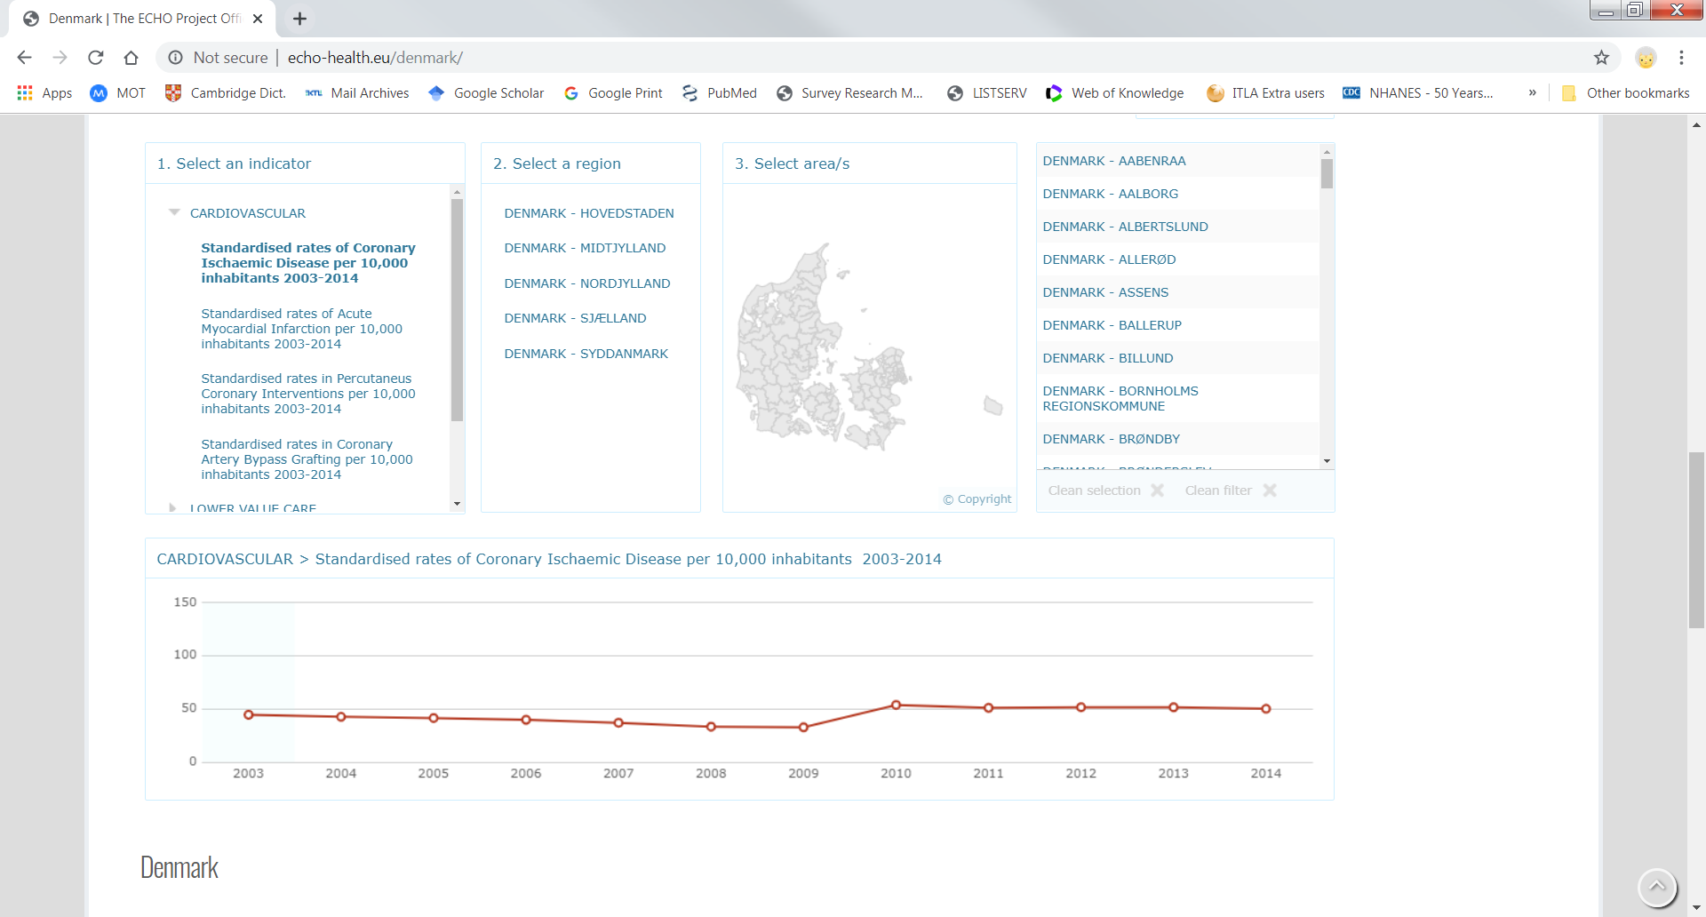
Available data

Slide 28
Available data by Research Networks
ECHI data tool at EU/DG SANTÉ on health indicators
ECHO Atlas
EHES data hosted by countries conducing national HES
EuroPeristat reports
EuroSafe Injury Database

Slide 29
Example of National Node: Finland
Data providers
Routine data/administrative data/registers
Statistics Finland: Mortality register
Finnish Institute for Health and Welfare (THL): Birth register, in- and out-patient hospitalizations, Malformation register, Cancer register, etc.
National Social Security Institution: Medical prescriptions, Social benefits etc.
Survey based data
THL: Health Interview Surveys incl. EHIS, Health Examination Surveys, Intervention studies (e.g. FINGER, D2D), Birth cohorts
Universities have a lot of research data they have collected within research networks, usually more regional data collections

Slide 30
Capacity building
Video and webinar courses
F2F training courses
Capacity building is the process by which individuals and organizations obtain, improve, and retain the skills, knowledge, tools, equipment, and other resources needed to do their jobs competently. It allows individuals and organizations to perform at a greater capacity.
Potter C, Brough R. Health Policy and Planning. 2004. doi:10.1093/heapol/czh038
Case studies
Capacity building
Workshops and seminars
Personal consultations and mentoring
Availability of material online

Slide 31
Capacity building on health information
EHES has online training materials, training seminars, provides personal consultations and mentoring
EuroPeristat organizes thematic workshops on different aspects related to collection of data
EuroSafe provides assistance to countries providing data to IDB, and organizes training events
F2F training courses
Video and webinar courses
Case studies
Capacity building
Workshops and seminars
Personal consultations and mentoring
Availability of material online

Slide 32
To work with existing building blocks from National Nodes and Research Networks to build a Research Infrastructure.

Slide 33
At national and EU level DIPoH will
Pooling existing resources
Better health and social care solutions for people
Contraction of effective health research and innovation environment
Improvement of national economy through better health of the population
Tools to identify and tackle health inequalities
Knowledge-base
Enhance and support secondary use of existing resources
Support for health technology innovations

Slide 34
Thank you!
Together we can accomplish our vision.

