Slide 1

The importance of health information research for informing policy
Assembly of Members | 13 November 2019 | Brussels
Marieke Verschuuren, MD MScHSR PhD
Public Health Consultant

Slide 2
Setting the scene: what are we actually talking about?
Policy-making & planning
Health information
Data sources: from other domains
Police data on e.g. injuries, violence
Environmental data
Data from the social domain
Etc.
Data sources: other sources on health
Vital statistics and demographics, CoD
Disease registries (e.g. cancer, DM)
Health interview and examination surveys
Etc.
Data sources: healthcare
(Electronic) health records
Administrative healthcare records
Patient reported information
Etc.
Notes:
Health information
Population level
Secondary purposes
Aggregated data (sometimes also microdata, but we do not use this because we want to distinguish person A, but because we want to do more detailed analyses and link across databases at the subject level)

Slide 3
Key concepts
Population level
Secondary use

Slide 4
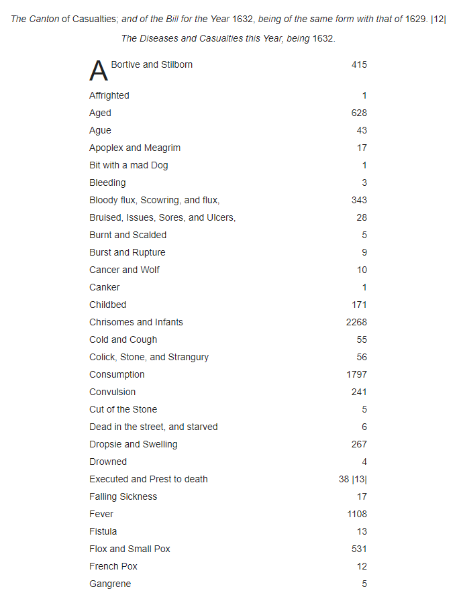
Natural and Political Observations Made upon the Bills of Mortality (Graunt 1676)
https://en.wikisource.org/wiki/Natural_and_Political_Observations_Made_upon_the_Bills_of_Mortality_(Graunt_1676)/Chapter_1

Slide 5
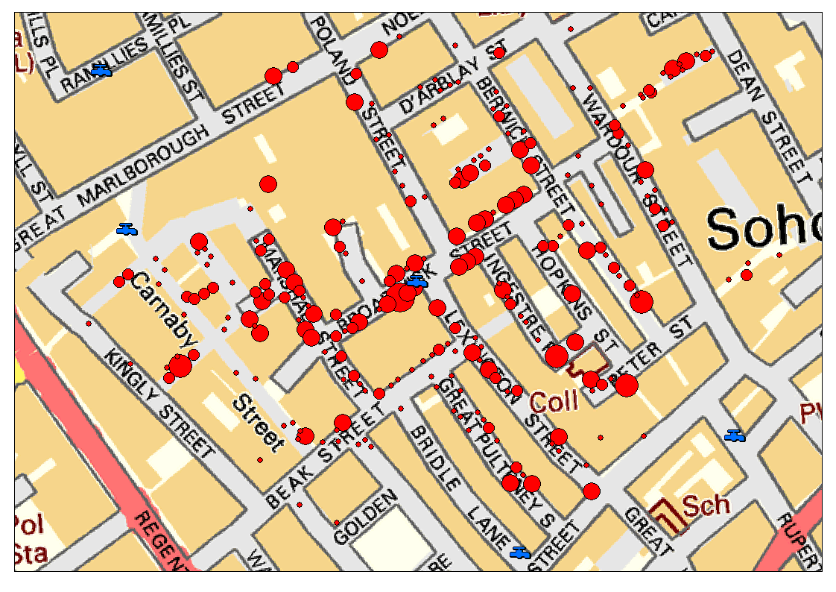
John Snow, 1854: mapping of the deaths caused by a cholera outbreak in Soho, London, and the locations of water pumps in the area.
http://blog.rtwilson.com/john-snows-cholera-data-in-more-formats/

Slide 6
Key concepts
Population level
Secondary use
Patterns & distribution of health

Slide 7
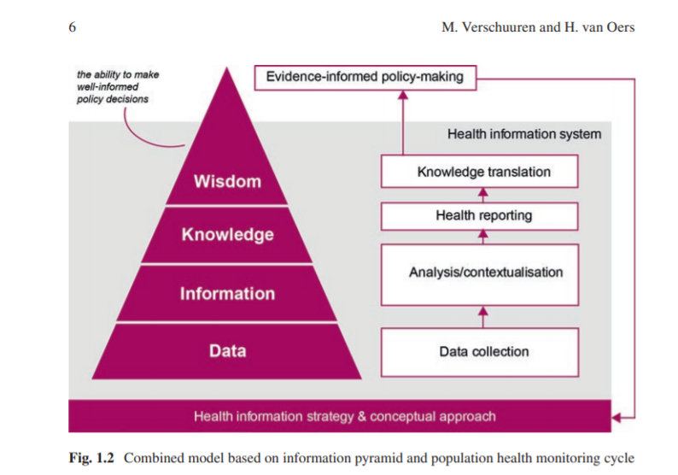
Health information is (much) more than just databases

Slide 8
Key concepts
Population level
Secondary use
Patterns & distribution of health
Data, analysis, reporting and knowledge translation

Slide 9
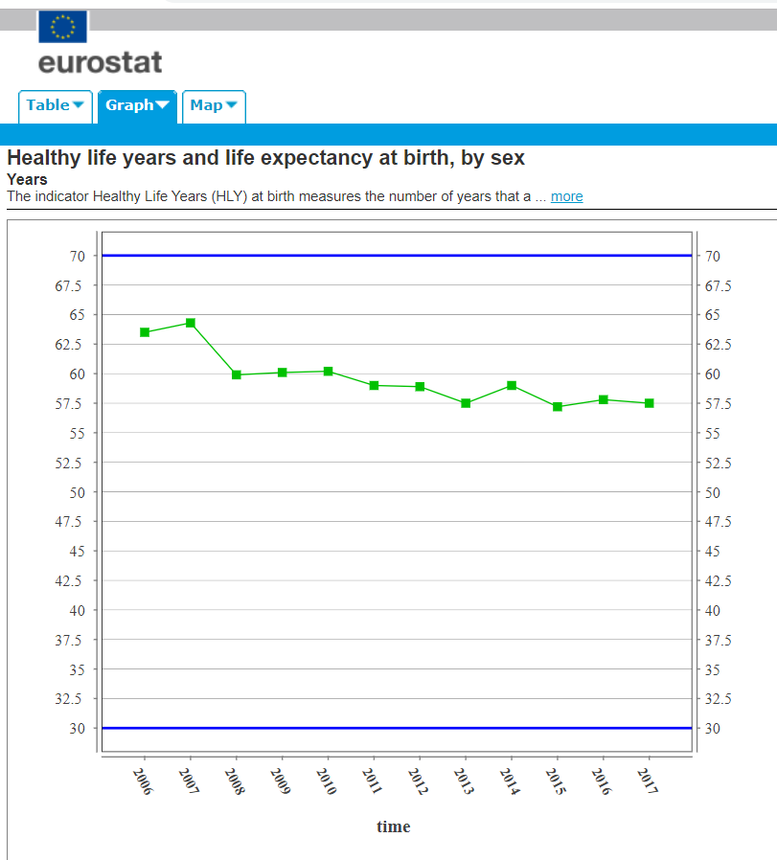
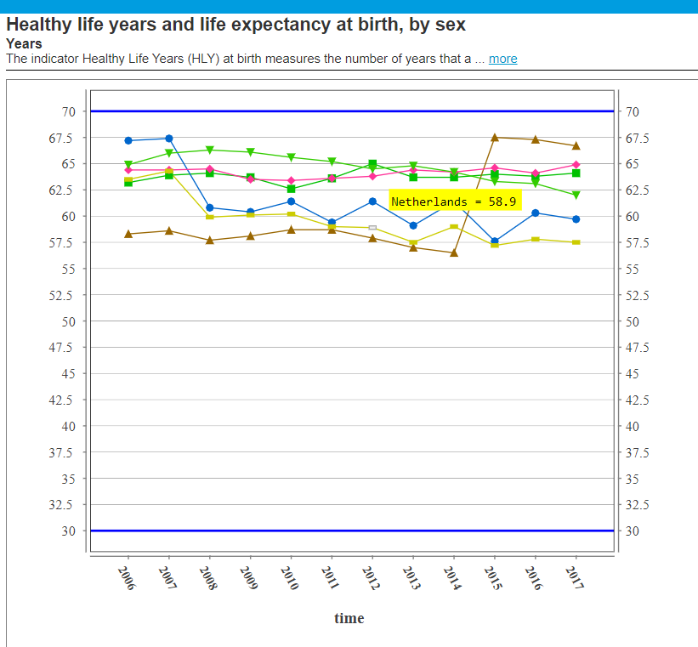

Slide 10
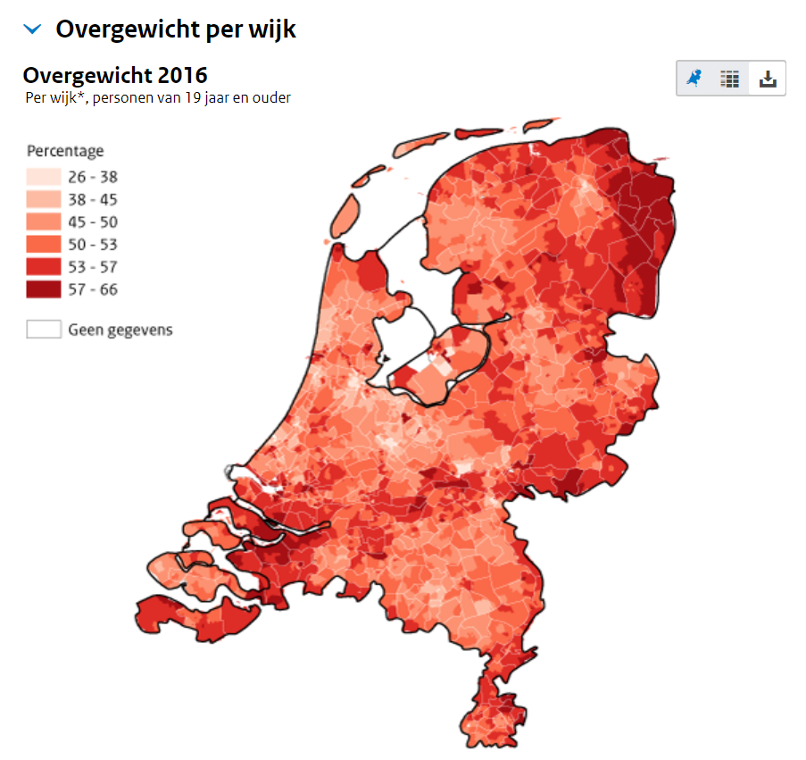
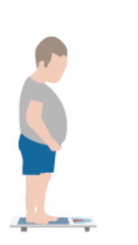
In 2018, just over 50% of the Dutch population aged 18 and over were overweight.
https://www.volksgezondheidenzorg.info/onderwerp/overgewicht/cijfers-context/samenvatting
https://www.volksgezondheidenzorg.info/onderwerp/overgewicht/regionaal-internationaal/regionaal#node-overgewicht-wijk

Slide 11
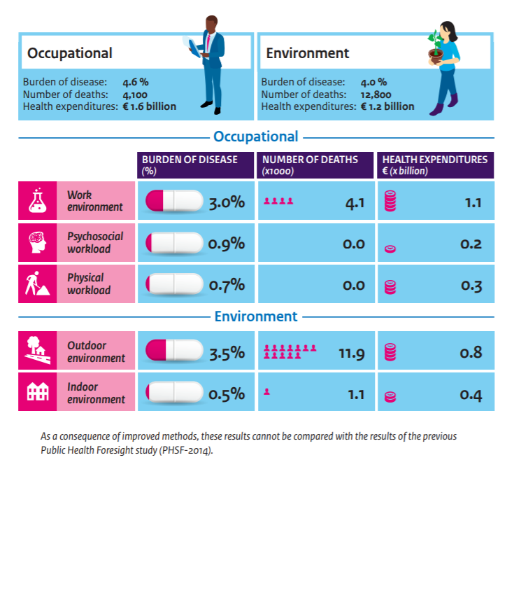
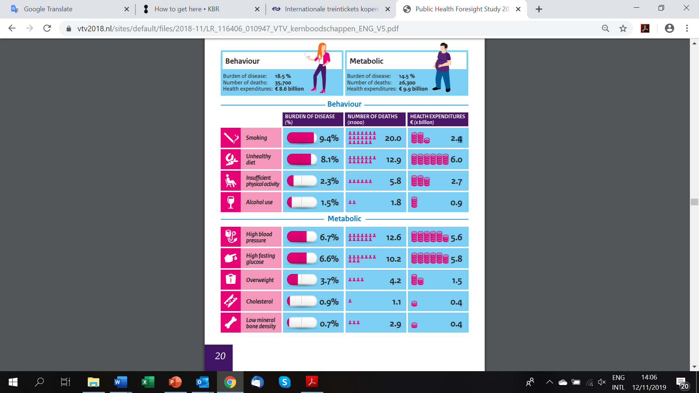
https://www.vtv2018.nl/en

Slide 12
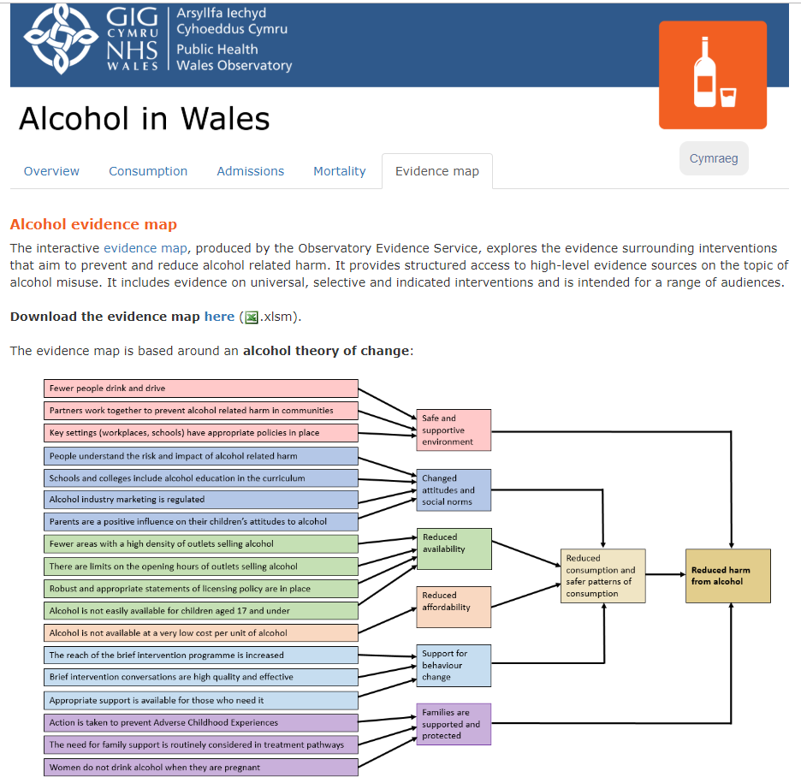
https://publichealthwales.shinyapps.io/AlcoholinWales/

Slide 13
Key concepts
Population level
Secondary use
Patterns & distribution of health
Data, analysis, reporting and knowledge translation
Importance of:
  Comparative information
  Integrative information
→ To answer policy questions such as: where is our action most needed or most urgent? Where will our actions have most impact? What kind of impact will our actions have? Which policies and interventions should we use?

Slide 14
Added value of international health information research
Usability of (new & existing) data sources for population health monitoring
Indicators for international comparisons
Methods for small area estimates
Integrative analyses and assessment frameworks
Best practices in health reporting and knowledge translation
Joint evidence resources
……..
Population level
Secondary use
Patterns & distribution of health
Data, analysis, reporting and knowledge translation
Importance of:
  Comparative information
  Integrative information

Slide 15
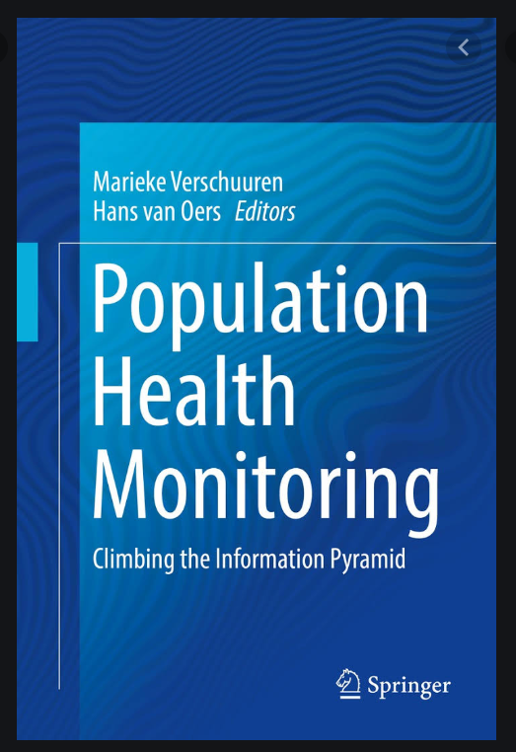
THANK YOU FOR YOUR ATTENTION!
Marieke Verschuuren
Public health consultant
info@mariekeverschuuren.nl
www.mariekeverschuuren.nl (content will be added soon!)
Interested to learn more?

