Slide 1

Piloting services & tools for public health research
November 13th, 2019
Enrique Bernal-Delgado on behalf of WP10 partners
ebernal.iacs@aragon.es

Slide 2


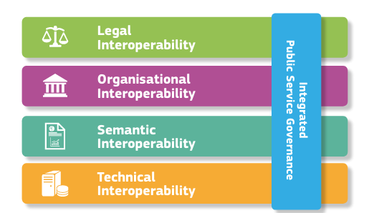






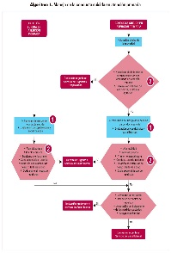









Reuse of routinely collected data
data collected in real life exchange …
… requires IO

Slide 3
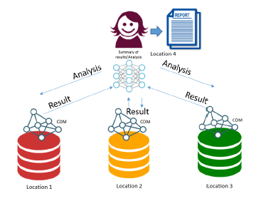



DIPoH
RN
RN
RN
DH
DH
DH
DH
DH
DH

Slide 4






In DIPoH: DH & RN
RN
DH
(*) Image by Song, J et. al. in International Journal of Population Data Science (2018) 3:3:3

Slide 5
Testing a distributed research infrastructure
Monitoring resilience
Spending in patients with dementia
Variation in care pathways for acute ischemic stroke

Slide 6
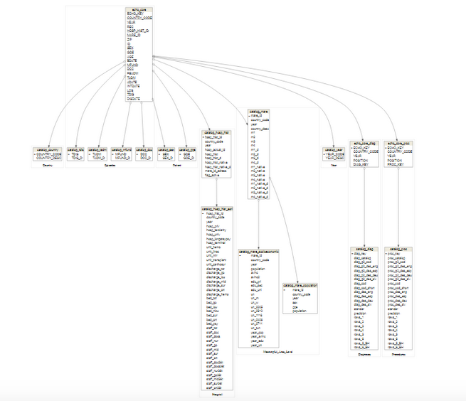
Data model: entities, dimensions, relations

Slide 7
Data model: semantic Interoperability
I63.539
I63.541
I63.542
I63.543
I63.549
I63.59
I63.6
I63.8
I63.9
I60.00
I60.01
I60.02
I60.10
I60.11
I60.12
I60.2
I60.30
I60.31
I60.32
I60.4
I60.50
I60.51
I60.52
I60.6
I60.7
I60.8
I60.9
I61.0
I61.1
I61.2
I61.3
I61.4
I61.5
I61.6
I61.8
I61.9
I63.19
I63.20
I63.211
I63.212
I63.213
I63.219
I63.22
I63.231
I63.232
I63.233
I63.239
I63.29
I63.30
I63.311
I63.312
I63.313
I63.319
I63.321
I63.322
I63.323
I63.00
I63.011
I63.012
I63.013
I63.019
I63.02
I63.031
I63.032
I63.033
I63.039
I63.09
I63.10
I63.111
I63.112
I63.113
I63.119
I63.12
I63.131
I63.132
I63.133
I63.139
I63.432
I63.433
I63.439
I63.441
I63.442
I63.443
I63.449
I63.49
I63.50
I63.511
I63.512
I63.513
I63.519
I63.521
I63.522
I63.523
I63.529
I63.531
I63.532
I63.533
I62.00
I62.01
I62.02
G46.0
G46.1
G46.2
G46.3
G46.4
G46.5
G46.6
G46.7
G46.8
I62.9
Haemorrhage
Ischaemic

Slide 8
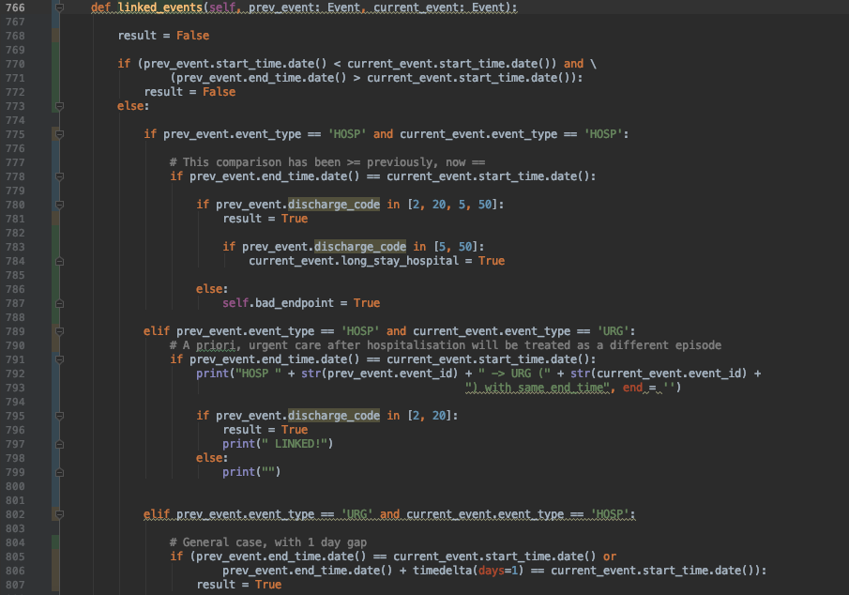
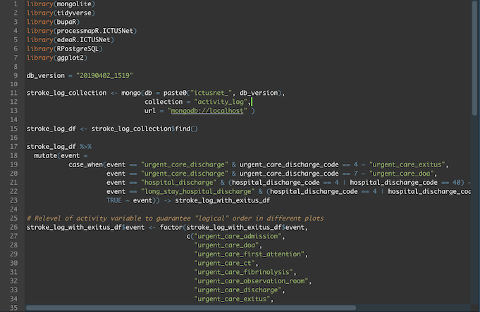
Sharing scripts to be run at home
LOG BUILDER
ANALYTICAL PIPELINE

Slide 9
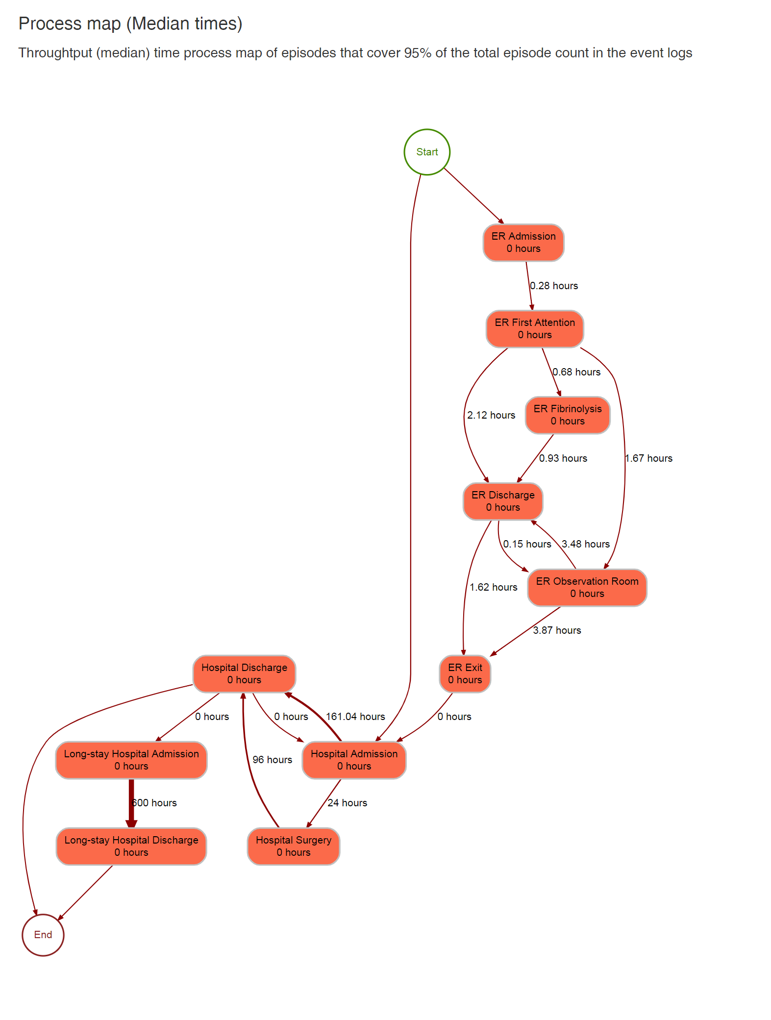
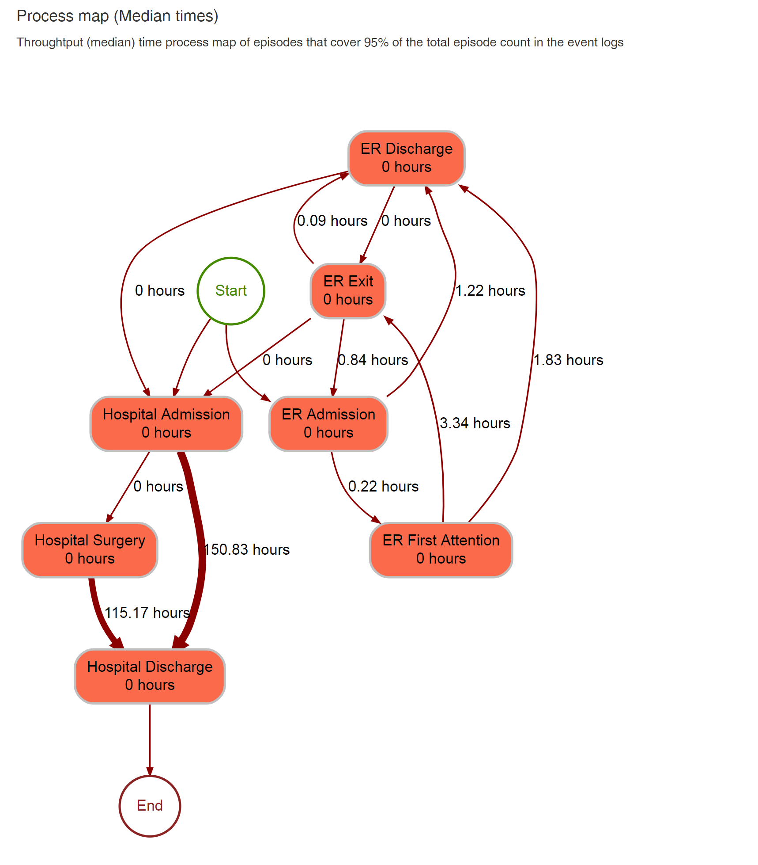
Getting and sharing outputs after running the code in two hubs
Ischaemic stroke PM in Hub 1
Ischaemic stroke PM in hub 2

Slide 10
DIPoH IO services & tools
IO Services & Tools
Development, distribution and/or maintenance of software on:
  Data models (e.g., cross-walking across taxonomies)
  Database builders (linkage and data management)
  Analytical pipelines for distributed infrastructures
  Research results reporting
Support and/or maintenance of existing research networks
Continuous mapping and distribution of open software solutions
Training and capacity building
Advice and/or expert support on IO for integration within DIPoH

