Slide 1
Distributed Infrastructure on Population Health DIPoH
Assembly of Members II – 13 November 2019, Brussles
Name: Linda Abboud, Petronille Bogaert and Herman Van Oyen
Institution: Sciensano, Belgium
Contact: infact.coordination@sciensano.be
Notes:
Setting out an improved EU health information system infrastructure

Slide 2
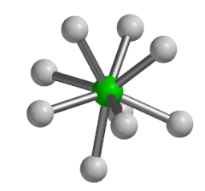
The concept of DIPoH
DIPoH
Connect networks and stakeholders
Enable top level research
(linked data, access systems, processes and capabilities, …. )
Policy change
Practice change
Technology change
Improved health and other outcomes
Achievement of outcomes at lower costs
Notes:
Enable: to identify sources, access sources, assess quality of source and reuse/

Slide 3
Framework of Population Health Information
Health Status
How healthy are citizens, what are their health needs and healthcare utilisation options?
Disease states
Functioning and Quality of Life
Healthy Life Expectancy
Mortality by cause, sex and age
Determinants of Health
What are the factors that determine the health of a population?
Health Behaviour
Personal Risks and Resources
Socio-Economic factors
(participation, financial safety)
Physical Environment
Health Care System
How does the health system perform? What is the level of care across the range of patient needs? What does this performance cost? How is prevention implemented (health protection, disease prevention [screening, vaccination], health promotion)?
Expenditure
Input (personnel, infrastructure, technology)
Accessibility
Utilisation
Quality, Effectiveness, Safety
Notes:
3 most important DOMAINS to understand population health and health systems:
What are drives of the dynamics of health of populations, what makes one population healthier than others and what is the impact of health systems in this. Health systems comprises close to 10% of GDP in most countries and in some countries even more. Better understanding as to what comprises a health system, its goals, and the underlying structure and factors that drive its performance in relation to health outcomes is therefore essential

Slide 4
Uniqueness of DIPoH
Covers the population as a whole (healthy and non healthy)
Focus on non communicable chronic diseases
Facilitate secondary use of routine data sources
Include individual and aggregated level data
Does not include experimental research
Boost national population health research

Slide 5
Filling the gap in RI landscape
BBMRI ERIC | [Bio banking]
CESSDA | [Social Science Data Archives]
EATRIS ERIC | [Translational medicine]
ECRIN ERIC | [Clinical research]
ELIXIR | [Bioinformatics]
EU OPENSCREEN ERIC | [Chemical Biology]
ESS ERIC | [Social Survey]
ERINHA | [Highly Pathogenic Agents]
ISBE | [Systems biology]
INSTRUCT ERIC | [Structural Biology]
METROFOOD-RI | [Food and nutritional metrology]
MIRRI | [Microbiology]
SHARE | [Aging (survey)]
Health
of Populations

Slide 6
DIPoH objectives
Support the development of large-scale, integrated and sustainable data services for population health and health services research
Catalogue information and knowledge generated by a critical and growing mass of European researchers and their international networks
Strengthen the synergy in the EU by facilitating comparative research, efforts at data linkage, pan-European (re)use of data, methods, results and better involvement of national experts
➔Ensure that research is findable, accessible, interoperable and reusable and create ever-stronger research networks.

Slide 7
DIPoH Structure
Central Office
National Node
National Node
National Node
National Node
Research Network
Research Network
Research Network
National Nodes (NN) units within MSs representing national network,
Research Networks (RN) and their research communities,
A Central office and governance structure,
A Web based portal as gateway to data, services and tools on population health
Web
Portal
Services support

Slide 8
Services

Slide 9
Activity layers
Core Activities
Catalogue of collections of FAIR data
Advisory services
Capacity building
Communication
Supporting Activities
Research development support
Research into practice support and knowledge translation
Strategic Activities
Knowledge brokering
Advocacy
Link to/collaboration with other ERICs
Horizon scanning
Joint research agenda and priority setting
Notes:
RI activities/services that facilitate the entire research process

Slide 10
I. Core Activities
Catalogue of collections of FAIR data Search engine: find data, find a network, find an expert, find data tools, knowledge translation tools and services Develop and maintain repositories for: international comparative datasets, indicator sets, research articles and reports from the networks, standards and guidelines, methods, metadata Facilitate access to relevant classification methods and standards Map of open access software solutions Literature searches and reviews Collective memory EU population health and health systems projects | Advisory services Guidelines to FAIR data and being in line with ELSI requirements Working with complex/big data; data model development, analytical pipelines, customized selection of data models Building a productive research network Writing hands-on guides on methodologies and tools for health information practitioners and researchers

Slide 11
I. Core Activities
Capacity building Support researches in MSs new to domain specific areas (setting up registries, surveys, improving quality of registries and surveys, stimulate data provision, data management plans, metadata, …) Real world data reuse Science of data Development of federated data infrastructures Manage specific capacity building projects Facilitate learning networks for researchers Organise and support expert exchange and teaching options | Communication News related to the DIPoH News from the international health information field (EU focus) Organise and signpost on health information research Maintain calendar of relevant health information events Allow domain specific networks to present their news Summarise bodies of health information related research for policy makes

Slide 12
II. Supporting Activities
Research development support
Help with legal and ethical aspects; forms, standards, regulations
Propose and design EU-wide data collection efforts- (Standardisation, interoperability)
Finding matches for research and funds/pools
Give advice when drawing up project descriptions
Provide general information and advice about European and other international research programs
Courses and information meetings
Contact and coordination in relation to EC staff in Brussels
Templates of EU projects and across sectors

Slide 13
II. Supporting Activities
Research into practice support
Interface for bottom-up approach for current issues and needs in health information
Relate indicators to decision making process
Methodologies for knowledge translation
Support the development of national/EU strategies for health information
Support and monitor the utilisation of information in practice
Draft reports on how to use health information

Slide 14
III. Strategic activities
Knowledge brokering
Broker for access to experts or expert advise
Broker for commissioning a full expert group
Broker for commissioning a specific report, review or data analysis
Broker for strategic advise and data improvement, data linkage, interoperability issues, etc.
Link to/collaborate with other ERICs
Share and provide services
Prevent duplication
Horizon scanning
Support for joint research agenda and priority setting
Advocate for EU health information

Slide 15
DIPoH illustrated
DIPoH
Notes:
➔FACILITING KNOWLEDGE
Make use of the infrastructure→
Data stays at home,

Slide 16
www.inf-act.eu @JA_InfAct infact.acoordination@sciensano.be

Slide 17
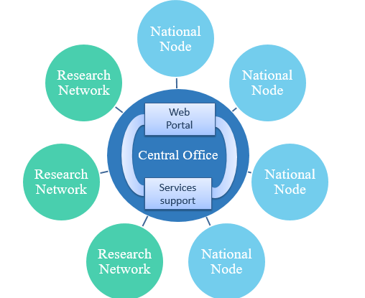
DIPoH central office
Central Office Management | Manage the RI governance and control; Develop Strategy; Evaluate functioning; Prepare & support committee meetings; Advocate; Organise the RI communication/PR; Provide administrative support
Central Office Web portal | Host website; Manage servers, databases, software, and updates; Develop & maintain a distributed data repository; Set up communities, webinars, etc.; Liaise with stakeholders; Knowledge brokering; Implement the RI services, in liaison with Services support for researchers
Central Office Services support | Manage, support and evaluate the services that the RI is offering open access, to members and by contract (fee for service), in liaison with Web portal;

Slide 18
DIPoH Nodes and Networks
National nodes | International: Know the international health information landscape; Represent country in RI Governance and Committees; Review international comparative reports; Liaise regarding capacity building; Comment on policy reports from research networks National: Know national health information landscape, including national health data strength and weaknesses and assets; Liaise with ministries of health and research; Liaise with national domain specific research network experts; Know the needs of MSs and how the RI can answer them; Match-maker between the RI and country
Research networks | National participation: Collect and prepare national data for international sharing; Know national data quality & particularities; Oversee & coordinate national data efforts for international use; International coordination: Leader role; Participate in meetings of the RI and liaise with other research networks; Provide general support (admin, web, data, training)

