Slide 1
Distributed Infrastructure on Population Health DIPoH
Assembly of Members II – 13 November 2019
Name: Linda Abboud, Petronille Bogaert and Herman Van Oyen
Institution: Sciensano, Belgium
Contact: infact.coordination@sciensano.be
Notes:
Setting out an improved EU health information system infrastructure

Slide 2
Rational: why an infrastructure?

Slide 3
Challenges
FRAGMENTATION
Disperse knowledge
Incomplete data
Difficult access
INEQUALITIES
Differences in quality
Diversity in research capacity
PROJECT BASED
No long term planning
Waste of resources
Duplication
➔ Need for EU health information infrastructure
Notes:
Health information activities are often funded through ad hoc projects rather than through sustainable structures.
Much of the gathered evidence and knowledge is still dispersed, incomplete and difficult to access.
Large differences can be found in terms of quality and, as a consequence, in comparability of health information between and within EU Member States.
Large health information inequality both in term of data production, data platforms – clouds, data analysis and inference

Slide 4
Need for infrastructure
Need for European strategy health information
Improved coordination between various health information activities (by different DGs, different agencies, different projects, etc.);
Need for interdisciplinary cooperation with non-health sectors and civil society;
Improving the link between health information activities including research and development, and policy needs;
Need for decisions on common issues;
Create synergies and sustainability between projects and health information activities.
→ Need for coordination and collaboration in health information.

Slide 5
Need for infrastructure
2. Data harmonization, collection, processing and reporting
Harmonization of data definitions and indicators between countries;
Standardised methodological approach to data collection (adapt to culture etc.);
Facilitate sharing and exchange of harmonised data at individual and population level;
Harmonized EU wide health reporting (including data visualizations);
Ensure sustainable data collections and data availability for evidence-based public health;
Better usage of collected data.
→ Better data quality and comparability.

Slide 6
Need for infrastructure
3. Comparison and benchmarking among MS and for Europe
Assess quality and efficiency health care systems;
Assess inequalities in Europe;
A unified general picture of health situation in Europe;
Addressing health determinants that operate across national boundaries.
Knowledge sharing and capacity building
Diminishing the health information inequalities between countries;
Developing knowledge and expertise and facilitating the exchange of knowledge and expertise including good practice examples.

Slide 7
Need for infrastructure
5. Transferability of health information research and evidence-based policy making
Developing, implementing and evaluating regional, national and EU actions;
Effectiveness and efficiency of public health interventions;
Respond effectively to population health and health systems’ challenges;
Fast health analysis for preparedness and research;
Efficient spending of resources.
→ Use research for evidence-based policy making, monitoring and planning.

Slide 8
Rational: why a Research Infrastructure?

Slide 9
Options
Strengthen existing structure
ECDC, JRC, Eurostat, DG SANTE.
Outsourcing: WHO, OECD
Create new independent structure
Independent new EU agency
Set up a Research Infrastructure → European Research Infrastructure Consortium (ERIC)

Slide 10
ECDC
Strengths
All member states can be involved
Can have a mandate to lead
ECDC is topic-driven (knowledge driven), know how to store data (GR4)
Weakness
An extension of the ECDC would require an amendment of the ECDC founding regulation.
A decision of the European Parliament and of the Council would be needed to install a separate surveillance system.

Slide 11
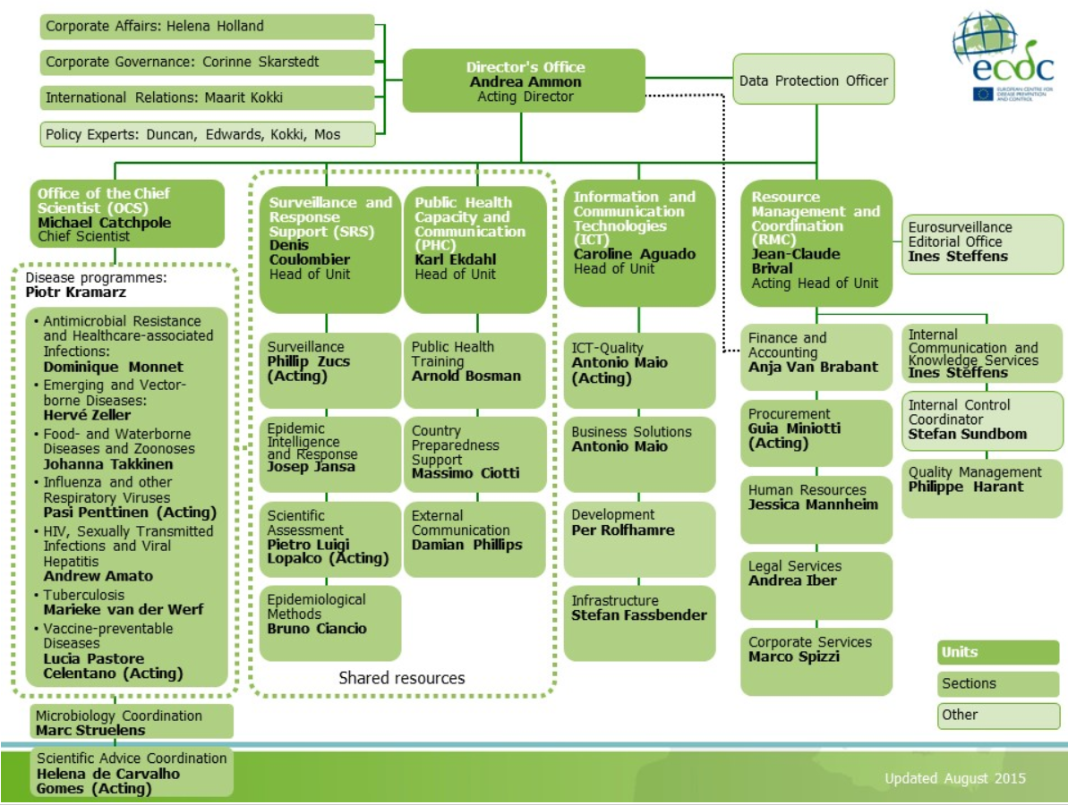
Cfr. services
Cfr. scope

Slide 12
ECDC
Weakness:
The annual budget of the ECDC would need to be increased and would require a financial commitment by the Commission.
Need political support by EU Member States
Would require appropriate resources at EU level that are currently not available (according to the Commission).
Too orientated towards infectious diseases → it should be very clear in their mandate that they have a task other than infectious diseases
➔ ECDC has an all-in-one approach; this might be a model for a long-term solution.

Slide 13
Eurostat
Strengths
Statistical authority of the EU
Development, production and dissemination of European statistics
Coordination of statistical activities of Community institutions
European statistics: defined by the European statistical programme (i.e. ESS surveys, collections of administrative data, legal basis or gentlemen's agreement)
Weaknesses
Eurostat is really statistical data oriented
No clear link with Ministries of Health or Research, mostly link with statistic institutions
No public health thinking as main function

Slide 14
JRC
JRC: mission is to provide EU policies with independent, evidence-based scientific and technical support throughout the whole policy cycle.
In public health the institute contributes to
harmonisation of cancer and rare diseases care in Europe;
promotion of healthy diets and life style;
disease prevention by countering of environmental and behavioural factors.
JRC is funded from Horizon 2020 and by Commission services

Slide 15
JRC
Strengths
Limited tasks in health but may develop expertise in registries
Research orientated
Weaknesses
Unclear priority setting
Budget within EC subject to cuts
Mandate should be adapted
Limited population health knowledge

Slide 16
DG SANTE
Strengths
The basis for activities is public health.
Weaknesses
Setting up a new unit means budget and staff will need to be reallocated
Possible lack of continuity and political support
Conflict between strategic policy development and practical day-to-day routine work on health information

Slide 17
e) Outsource: WHO, OECD
Formalise cooperation with international organisations
Strengths
Experience and expertise
Influential to Member States (MS)
Reduction of reporting by MS
Weaknesses
Not fit for health information needs in EU
Own agenda
Limited research and new data development
Limited funding
Knowledge is moved to international organization
Setting up of Memorandum of Understanding
MS are not part of bilateral agreement

Slide 18
Options
Strengthen existing structure
ECDC, JRC, Eurostat, DG SANTE.
Outsourcing: WHO, OECD
Create new independent structure
Independent new EU agency
Set up a Research Infrastructure → European Research Infrastructure Consortium (ERIC)

Slide 19
Independent new EU agency
Strengths
Tailored to specific needs, focus on what you want
They have their own voice → better advocacy and visibility
Clear vision and goals
Link with international organisations
Familiar model
Ministries of health and research work together
Weaknesses
Need to start from scratch, not existing
Lot of work
Need for strong political will
Would take a long time to be set up (Those who seed will not harvest)
No legal framework

Slide 20
Research Infrastructure
Allows responses to current needs and demands with high usability for Member States and EU institutions → focus efforts on priority aspects
Has possible funding mechanisms: participation in calls of MS, EC and MS contribution
Ensures linkage with the scientific community, national infrastructures and international organisations
Is a flexible tool: reduction or expansion of activities based on the health information needs.
Can provide relevant information for decision makers and has the capacity to bring together different actors in health information
Can ensure continuity of existing health information activities
➔ Is the most feasible solution in the current setting

Slide 21
www.inf-act.eu @JA_InfAct

