Slide 1
Maternal and newborn health in Europe: surveillance and research
Jennifer Zeitlin, Marie Delnord
InfAct – Assembly of Members
12th March, Madrid, Spain

Slide 2
Maternal and newborn health: A priority for surveillance and research in Europe
In Europe, every year:
over 5,000,000 births
Burden of ≈ 40,000 stillbirths and infant deaths; 350,000 preterm births; ≈8 per 1,000 births with severe impairments
There are wide differences between and within countries which perpetuate social health inequity
Events during the perinatal period are associated with health later in life
i.e. Healthy pregnancy and infancy lowers the risk of metabolic and other chronic diseases in adulthood
A key challenge is to benefit from new technologies while limiting iatrogenic effects and costs

Slide 3
EU-funded initiative, started in 1999
The project aims to monitor perinatal health in the EU based on valid and reliable routinely collected indicators
Population-based data during pregnancy, delivery and the postpartum
Aggregate data on all pregnant women, live births and stillbirths
Vital statistics, Medical birth registries, Hospital discharge data
Years available: 2000, 2004, 2010, 2015

Slide 4
Why monitor across Europe ?
European countries face common challenges
Approaches to perinatal health differ greatly throughout Europe
Many country-level indicators are not comparable
Key indicators are not available in international databases (preterm birth rate, maternal smoking)
Notes:
4

Slide 5
Network of 31 countries
Notes:
Our network expanded over the years from 15 originally with recent countries that have joined are Bulgaria and Romania.
The network now includes 31 partners from 27 EU MS, Iceland, Norway and Switzerland. It includes one official member from each country who serves as the scientific committee (SC) representative.
Many countries have constituted teams with participation from multiple actors – clinicians, epidemiologists and statisticians who provide expertise and data for the project.
Members of these teams participate in Network meetings and studies. 100 active members
The list of SC members and the composition of country teams can be accessed on our website: http://www.europeristat.com/our-network/country-teams.html.

Slide 6
30 Euro-Peristat indicators
Notes:
Recommended: also smoking and BMI

Slide 7
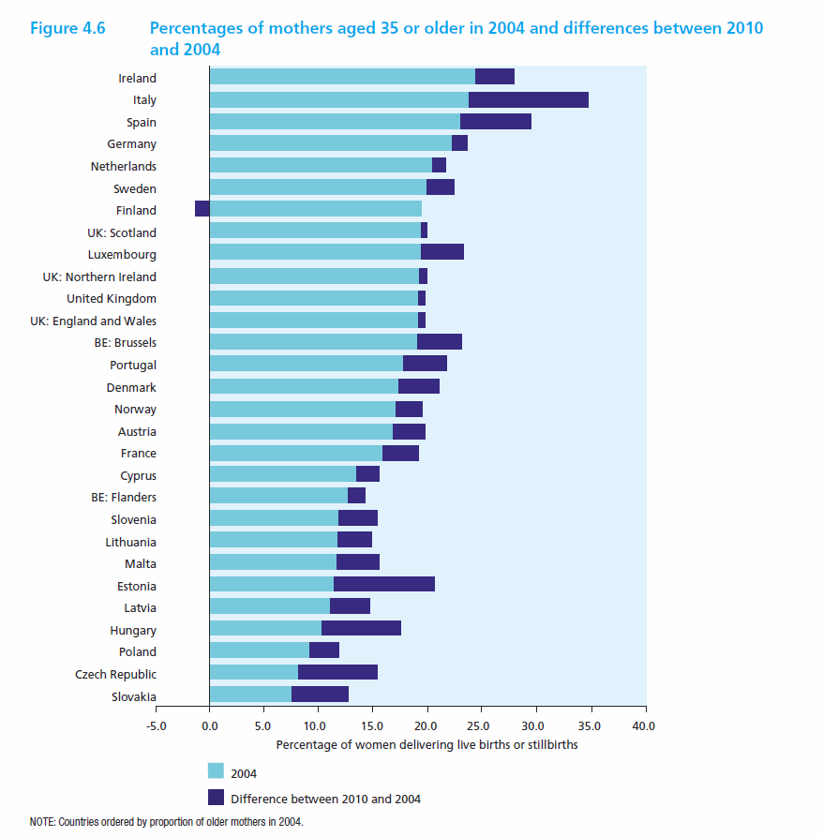
From knowledge to action
Good health policies and practices need good research and evidence
Notes:
Carefully conducted and analyzed research can save lives by helping decision makers design effective policies and programs. For research to influence policy, however, it needs to be communicated effectively and used in the decision-making process.

Slide 8
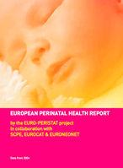
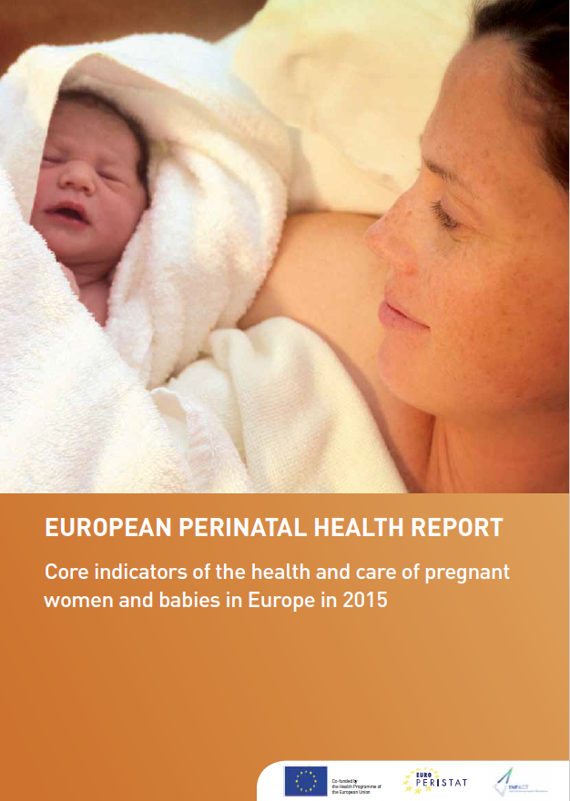
Dissemination of results
The European Perinatal Health Reports
Data on indicators available on the internet
Scientific and professional conferences and publications
Notes:
We use different channels to communicate out results. The goal is to facilitate access to Euro-Peristat data to have a broad reach on stakeholders in academia, ministries of health, ministries of research and public health agencies, but also for user groups and families

Slide 9
Research activities are integral to Euro-Peristat
Publications are a major incentive for participation among our network members
Results are used to inform clinical guidelines, policy briefs, and to improve the quality of perinatal health monitoring
Peer-review adds validity to all Euro-Peristat products
Potential to generate revenue streams by leveraging data and expertise

Slide 10
Euro-Peristat data for research
Investigate the population determinants of maternal and child health
Our indicators are used to generate hypotheses about the reasons for differences in health
Identify high and low performers to set benchmarks for policy & practice
The Netherlands: poor perinatal mortality rankings were a strong incentive for Dutch politicians and professionals to introduce a perinatal mortality audit and assessment of the quality of care. This resulted in the reorganization of antenatal care including for home births, and mortality at term declined by 39% from 2004 to 2010
Germany: Introduction of a new legislation mandating a minimum number of 14 annual admissions of neonates under 1250 g in order to operate as a level III perinatal centre.
Develop better methods for cross-country data collection/analysis
Collaborate with other EU research projects
CONCEPTion, H2020 IMI (Innovative Medications Initiative, public private partnerships)–use of medication during pregnancy and breastfeeding, starting April 2019

Slide 11
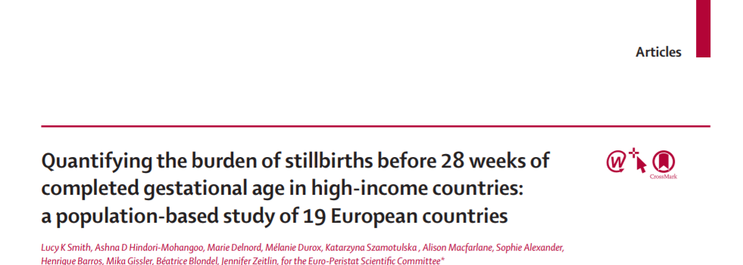
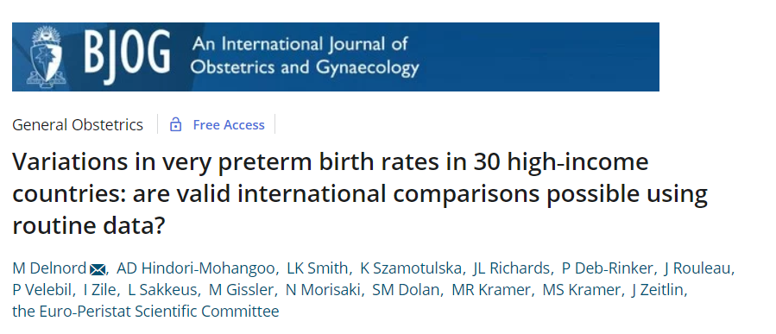
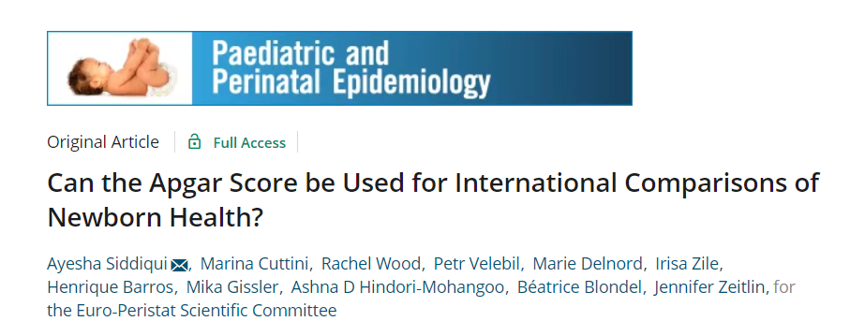
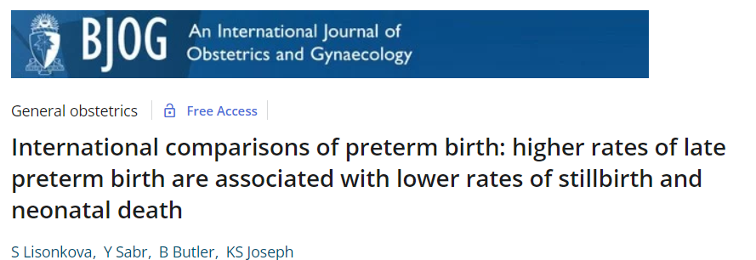
+ 55 publications in high-impact journals
Not only by our team, but also by other researchers who use Euro-Peristat data in open access

Slide 12
Impact at EU and global level
Participation in global initiatives on preterm birth and stillbirth prevention

Slide 13
European Research Infrastructure
Strong added-value for the Euro-Peristat network
Research at EU level provides strength in numbers by increasing the capacity to detect population determinants with a small but cumulative impact on health
An opportunity to foster research beyond what is possible now
Solution-oriented research by extending hypotheses to the social and environmental determinants of health:
Environmental risk factors and adverse birth outcomes impact of air pollution, fine particulate matter
More refined analyses of health inequities in link with GDP, household income, neighborhood deprivation
Testing innovative research designs
Life course analyses requires capacity for data linkage within countries and harmonized procedures for data sharing across countries
Notes:
In general, but more specifically

Slide 14
Our vision for sustainable perinatal health reporting
Regular collection of the Euro-Peristat indicators
Data repository
Data managers with expertise to insure data quality
A pluridisciplinary network of experts who meet regularly to analyze and interpret data
Collaborations with national, European and global stakeholders to leverage these data
European Research Infrastructure
Research support for innovative analyses
Facilitate participation in European research projects across domains
Notes:
In conclusion

Slide 15
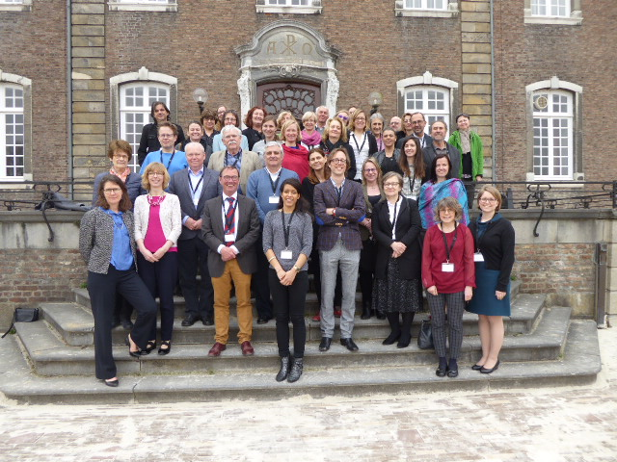
Notes:
Support from 31 partner countries and the European Union

Slide 16
Backup slides

Slide 17
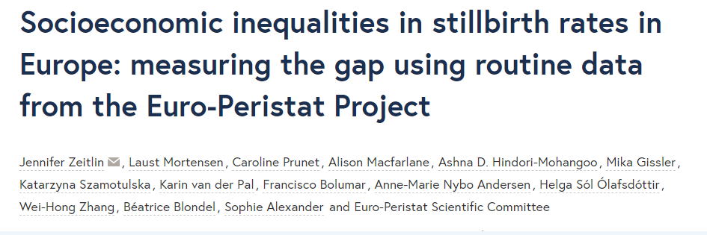
Social inequalities
contribute to high
stillbirth rates

Slide 18
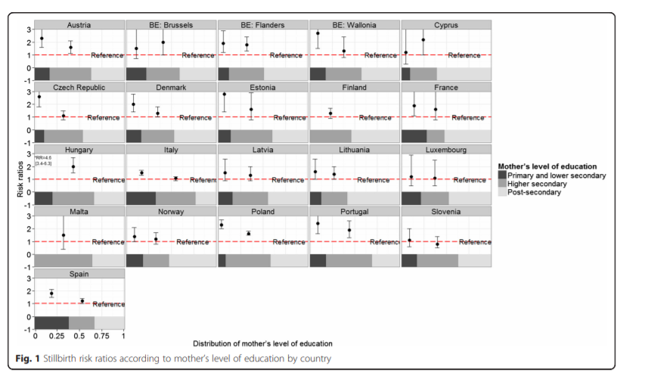

Slide 19
Estimated reduction in stillbirths without educational inequalities, 19 European countries in 2010

