Slide 1
The Health Information Research Infrastructure
Assembly of Members – 12 March 2019
Name: Petronille Bogaert, Linda Abboud and Herman Van Oyen
Institution: Sciensano, Belgium
Contact: infact.coordination@sciensano.be
Notes:
Setting out an improved EU health information system infrastructure

Slide 2
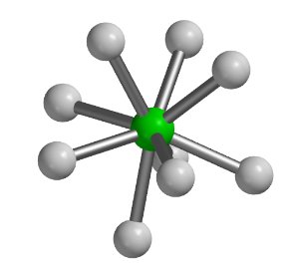
The concept
Enable top-level research
Improve public health
Connect networks
Support evidence informed policy
Notes:
The Health Information Research Infrastructure is about connecting networks in health information and overcome fragmentation to enable top-level research for better evidence more intelligence to support evidence informed policy with the overarching aim to improve public health (population health and health care system)

Slide 3
The goals
To make available and share quality data, information and tools
To strengthen scientific knowledge, promoting scientific cooperation and integration
To support expertise development, methodological innovation and use of health information to inform policy

Slide 4
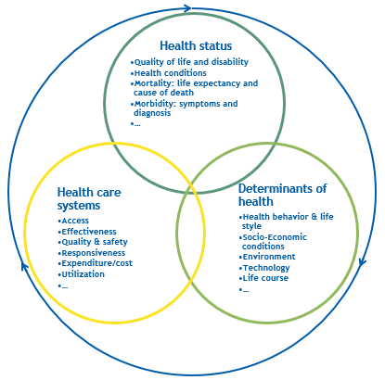
Scope: fill the gap
Population health and health care systems
Insurance
data
Big data
Disease Registries
Vital
statistics
Hospital Care
data
Indicators
Guidelines and manuals
Survey
data
Notes:
Tools that we are putting toegther to answer your questions in these areas. The questions you have a re evolving. We will develop new tools to respond to your demands

Slide 5
What? Health Information Research Infrastructure
Distributed Research Infrastructure:
National network (NN) units within MSs,
Participating domain specific networks (DSN) and their research communities,
A central office,
A web based platform that delivers services,
A set of core RI activities in the form of focused projects and programmes (in contact with NN).
Central office with platform
National network
Domain specific network
Domain specific network
Domain specific network
National network
A domain specific network is generally a group of collaborating researchers on a common health topic or method.
The national network is a consortium of relevant national actors.
Notes:
Should be same figure as mine.
CAN YOU GIVE SOME EXAMPLES OF THESE ACTIVITIES (or do you refer to the 3 mains blocks (one stop shop/ innovative methods/
From RIVM text: Central activities:
guide, support, monitor, evaluate project progress: scientific support for project development, reporting and reformulation; capacity building: estimated number of capacity building projects per year(3-6); health reporting: 5-10 four yearly policy reports by 5-10 domain networks; two large EU-wide data collecting efforts per year; costs(rooms, lunches…)per project meeting; travel & substances; HI and data schooling/training programs; I-models; yearly conference health information.

Slide 6
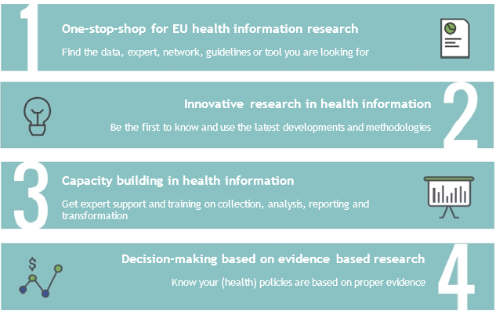
Services
Policy-making
Knowledge translation
Health reporting
Analysis, research contextualisation
Data collection
Notes:
Ondersteunen onderzoekers om dit te doen.
1, 2 en 3 leiden tot 3.
Verschuuren et al. “Towards an overarching European health information system. 2017
HIS can be defined as a complex, multi layered system, aimed at producing health intelligence.
The steps relevant for population health monitoring (right side) and the outputs of an HIS (left side) are described as a combination of the population health monitoring cycle and data-information-knowledge-wisdom hierarchy models.
Definitions
Health information system is defined as:
“An integrated effort to collect, process, analyse, report, communicate and use health information and knowledge to influence policy and decision-making, programme action, individual and public health outcomes, and research”
An EU health information system
effort to collect, process, analyse, report, communicate and use comparable health information and knowledge
covering all Member States, EFTA and associated countries
to understand the dynamics of the health of the European citizens and populations in order
to support policy and decision-making, programme action, individual and public health outcomes, health system functioning, outputs and research in the European Union.

Slide 7
Services
Find network
→ DSN or NN
Find expert
→ Who is Who?
Find data
Find guideline or tool

Slide 8
Services
Computing services
Interoperability services
Tool services
Legal and ethical support
Notes:
GDPR and ethical aspects

Slide 9
Services
Overview training programs
Training services
Expert support

Slide 10
Services
Engagement with policy makers
Knowledge translation support
Advocate for EU health information
Horizon scanning
Notes:
The research outputs provides you the necessary tools for decision making.

Slide 11
Services
International
Expert groups

Slide 12
Added value for research
1) EU-comparative data | 2) Collaboration
FAIR health information Data quality checks Larger cohorts for research Enhanced data access flow Structured scientific exchange Produce quicker results Ensure ethical and legal compliance | Organize and connect public health expertise and systems Create synergies between projects and health information activities Better access to existing knowledge and expertise

Slide 13
Added value for society
Decision makers | Citizens and health care providers
Quality information for evidence based decisions. Better preparedness. International comparison: evaluate and discuss how to tackle similar challenges. Programme evaluation. | Improved health and wellbeing by enhanced monitoring of health risks, health status, health determinants, and the safety and quality of healthcare services. Evidence-based care. Reduced health inequalities.
Administrators/ data providers | Financers
Reduce burden by providing overview of international data collection → reduce duplication. Assist in obligation to provide data to international sources. | Better value for money in international health information activities. Optimise funds allocation.

Slide 14
Research Infrastructure outcomes
FRAGMENTATION
Disperse knowledge
Incomplete data
Difficult access
INEQUALITIES
Differences in quality
Diversity in research capacity
PROJECT BASED
No long term planning
Waste of resources
Duplication
CONNECTING STAKEHOLDERS AND INFORMATION
EFFICIENT (RE)USE OF DATA
CAPACITY TRAINING
KNOWLEDGE TRANSLATION
SUSTAINABLE INFRASTRUCTURE
KNOWLEDGE DEPOT
RETURN OF INVESTMENT

Slide 15
www.inf-act.eu @JA_InfAct

