Slide 1
The Joint Action on Health Information InfAct
Assembly of Members – 12 March 2019
Name: Petronille Bogaert, Linda Abboud and Herman Van Oyen
Institution: Sciensano, Belgium
Contact: infact.coordination@sciensano.be
Notes:
Setting out an improved EU health information system infrastructure

Slide 2
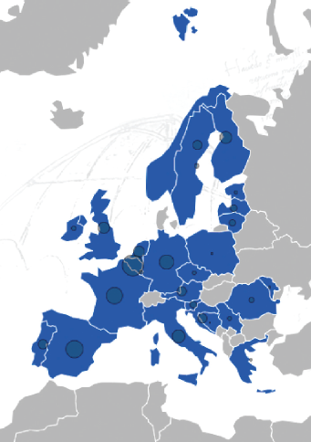
InfAct partners
40 institutions in 28 countries:
Austria, Bosnia Herzegovina, Belgium, Croatia, Cyprus, Czech Republic, Estonia, Finland, France, Germany, Greece, Ireland, Italy, Latvia, Lithuania, Luxembourg, Malta, Moldova, Netherlands, Norway, Poland, Portugal, Romania, Serbia, Slovenia, Spain, Sweden, United Kingdom
➔ 20 public health or research institutes, 13 ministries, 3 universities and 4 others

Slide 3
Goals of InfAct
InfAct’s goals are to strengthen national and EU health information systems by:
1. Establishing a sustainable research infrastructure which will support population health and health system performance assessment.
2. Strengthening European health information and knowledge bases and health information research capacities to reduce health information inequalities,
3. Supporting health information interoperability and innovative health information tools and data sources.

Slide 4
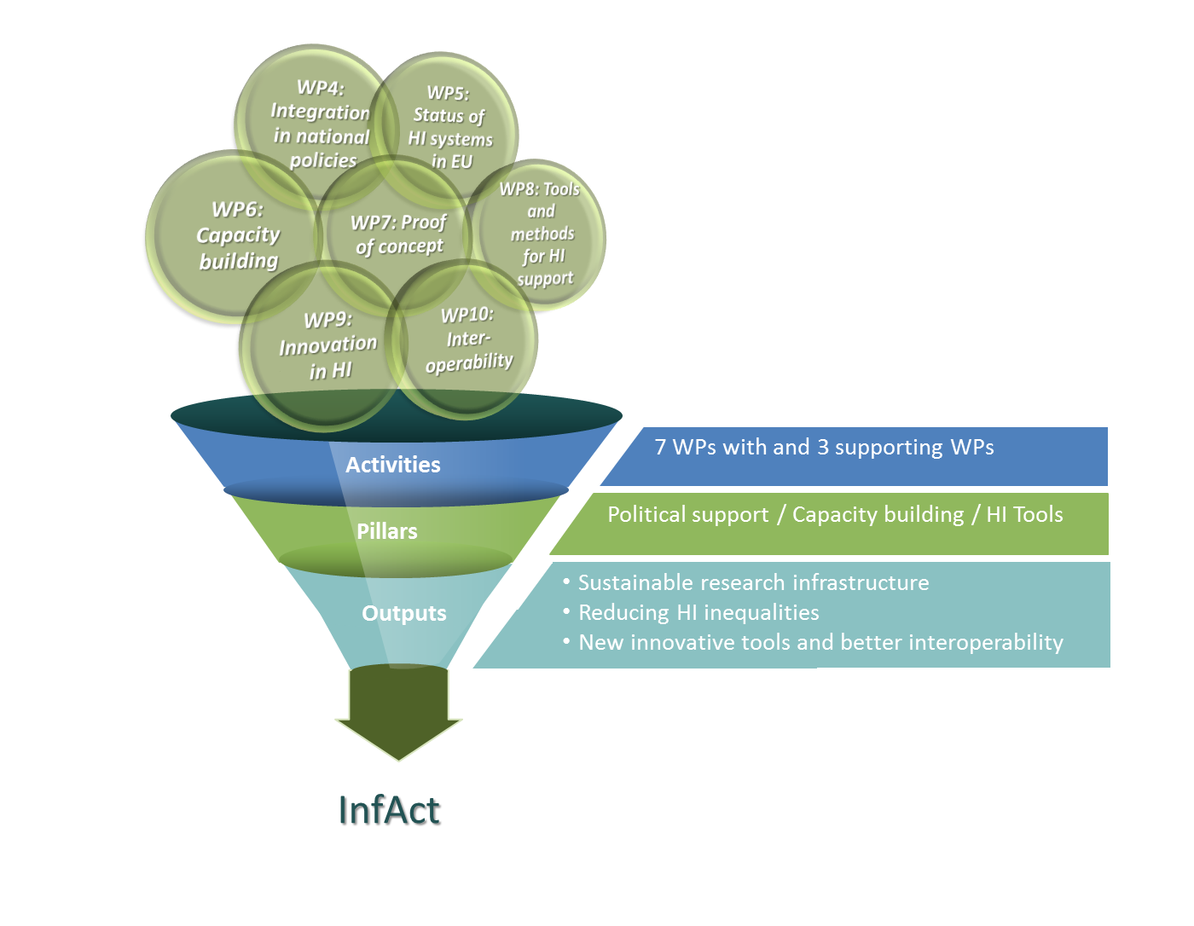
Notes:
Conceptual Framework
Three pillars:
Political support focusing on the development of a business case and road map for implementation of the RI, and the integration of HI into regional and (inter)national policies
Capacity building focusing on assessing HI systems through peer review, developing a flagship training to reduce HI inequalities, identifying relevant HI networks and prioritization strategies.
HI tools focusing on improving the quality of data, the development of new ways of using existing data sources to derive indicators, the use of new technologies for HI, and interoperability of health data instruments and sources.

Slide 5
Notes:
InfAct workpackages

Slide 6
WP4, WP5
Organisation of Assembly of Members with representatives from Ministries of Health and Research.
Sustainability plan.
Assessment of health information systems through peer-review.
Cataloguing of networks and projects.
Prioritization of health information

Slide 7
WP6, WP7
Developing a capacity strengthening baseline programme at EU level to support critical areas of health information use and management
Flagship training programme
Roadmap for capacity building
Developing a proof of concept of a sustainable organisational structure - working towards ERIC by:
Application for ESFRI roadmap
Connection of MS health information networks
Connection pan-European research networks
Development business case and roadmap
Creation of web-based platform

Slide 8
WP8, WP9, and WP10
Health monitoring data collection methods and indicators
Guidelines on accessibility, availability, and reporting in health information
Sharing inspiring examples from MS on emerging indicators and data sources to target priority public health actions and health care strategies
Enlarging the set of morbidity indicators available across the EU
Mapping and analysing (inter)national inspirational case studies on public health interoperability
Developing empirical work through case studies and pilots

Slide 9
Outcomes of InfAct
Increased Capacity Building and Research Targeting
Enhanced Sustainability and Robust Data Collection
EU Research Infrastructure
Improved Inter-operability and Innovation in HI
Advanced Scientific Knowledge
Informed Decision Making for Research and Policy

Slide 10
Website: www.inf-act.eu Twitter: @JA_InfAct

