Slide 1
Health Information Research Infrastructure-The ESFRI roadmap application
Assembly of Members – 12 March 2019
Name: Herman Van Oyen, Linda Abboud, and Petronille Bogaert
Institution: Sciensano, Belgium
Contact: infact.coordination@sciensano.be

Slide 2
ESFRI Lifecycle Approach
Implementation Phase
Central hub construction & deployment of nodes government & management structures
secured funding for operation
Operational Phase
Frontier research results, services to scientific community, continuous upgrade of instrumentation & methods, sustainability
plan
Design Phase
Design study, business case, political and financial support obtained, common access policy, top-level breakdown of costs,
Governance & HR
policy.
Preparatory Phase
Business & construction plan, political and financial support secured, data policy & data management plane, cost book

Slide 3
Why? Applying for ESFRI
Stepwise and structured process to set up a European Research Infrastructure Consortium (ERIC) on Health Information
Stamp of scientific excellence, its Pan-European relevance, and the socio-economic impact
Opportunities for European funding
Engagement of MS and collaboration of research institutions at operational level
Notes:
Nadruk op pan Europese

Slide 4
ESFRI vs. ERIC
ESFRI roadmap:
Political commitment
Recognition as EU priority
Cooperation and agreement between institutes
No upfront financial obligations by MSs
Can develop into ERIC
ERIC:
Political commitment
Recognition under EU law
Upfront commitment by MSs for provisional budget for the first 3-5 years
Notes:
To say that paralleled application is also possible

Slide 5
What? Health Information Research Infrastructure
Distributed Research Infrastructure:
Central office with platform
National network
Domain specific network
Domain specific network
Domain specific network
National network
National network (NN) units within MSs,
Participating domain specific networks (DSN) and their research communities,
A central office,
A web based platform that delivers services,
A set of core RI activities in the form of focused projects and programmes (in contact with NN).
Notes:
Should be same figure as mine.
CAN YOU GIVE SOME EXAMPLES OF THESE ACTIVITIES (or do you refer to the 3 mains blocks (one stop shop/ innovative methods/
From RIVM text: Central activities:
guide, support, monitor, evaluate project progress: scientific support for project development, reporting and reformulation; capacity building: estimated number of capacity building projects per year(3-6); health reporting: 5-10 four yearly policy reports by 5-10 domain networks; two large EU-wide data collecting efforts per year; costs(rooms, lunches…)per project meeting; travel & substances; HI and data schooling/training programs; I-models; yearly conference health information.

Slide 6
How? The steps within InfAct
Connecting National Networks in MSs
Engaging Domain Specific Networks
Situating of the RI in the HI landscape
Setting up web based platform
Fine-tuning the services to be provided and develop a model for their implementation
Interact with relevant stakeholders in HI field
Submission of the ESFRI application

Slide 7
Stakeholders in Health Information RI field
Existing Infrastructures
MSs
Research and PH institutes
International
Other
Expert groups

Slide 8
Potential research communities
Notes:
Research communities- these will also be our users

Slide 9
When? The timeline
ESFRI
Active Project
HI-RI Foundation
Full capacity
ESFRI Roadmap 2021 application
Preparatory phase
Design phase
Implementation
ERIC
Interim phase I
Interim phase II
Economic evaluation
2018 | 2019 | 2020 | 2021 | 2022 | 2023 | 2024 | 2025 | 2026 | 2027 | 2028 | 2029 | 2030
June 2019 ESFRI Guidelines
April 2020 ESFRI 2021 Call

Slide 10
Application

Slide 11
Application requirements
Full application including strategy and business case
Expression of political support (EoS)- by the lead country and at least two additional MS or associated countries signed by the national ministries responsible for RI
Expression of Commitment (EoC)- mainly by the lead country and additional prospective member countries to financially contribute to the preparation and implementation phases by an authority from the lead country
Inter-institutional and multi-lateral agreement by lead institutes identified within each country representing all national research institutes involved in the RI

Slide 12
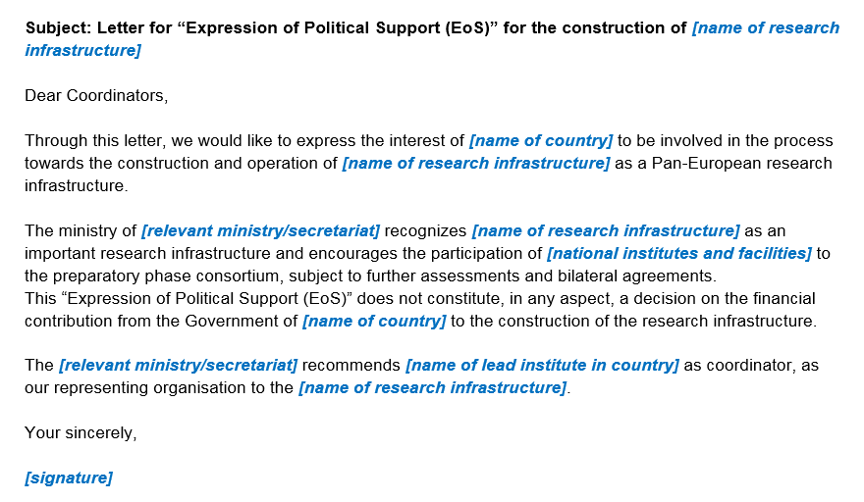
Example EoS

Slide 13
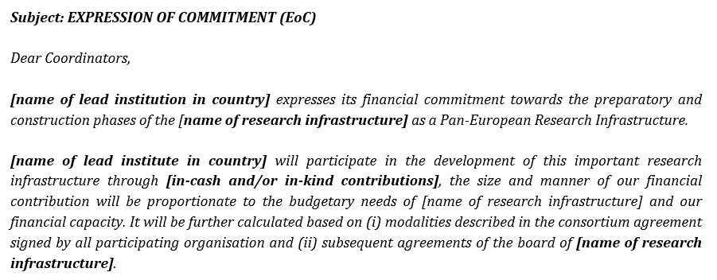
Example EoC
Notes:
In kind estimates examples:
Experts contribution to ---- project activities:
Equivalent staff cost of quart time various SENIOR scientific experts : 30,000/year
Equivalent staff cost of quart time various JUNIOR scientific experts : 22,5000/year
Equivalent staff cost of quart time various TECHNICAL experts : 15,000/year

Slide 14
www.inf-act.eu @JA_InfAct

