Slide 1
ESFRI ROADMAP
Madrid, 12th March 2019
Gonzalo Arévalo Nieto
Deputy Director
International Research Programmes
and Institutional Relations

Slide 2
CONTENTS:
What is an European Research Infrastructure
Organisation of the EU Research Infrastructures and the ESFRI ROADMAP
ESFRI Landmarks and RI Projects
ERIC, the often way to develop towards the ESFRI Landmark

Slide 3
CONTENTS:
What is an European Research Infrastructure
Organisation of the EU Research Infrastructures and the ESFRI ROADMAP
ESFRI Landmarks and RI Projects
ERIC a one way to develop the ESFRI Landmark

Slide 4
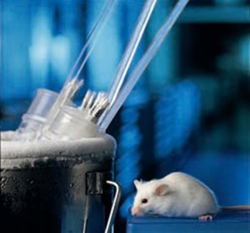
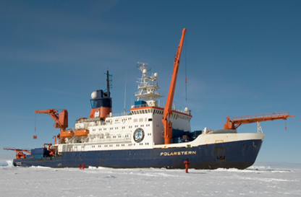
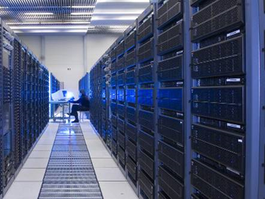
What is an European Research Infrastructure
Research infrastructures are facilities, resources and services that are used by the research communities to conduct research and foster innovation.
Some times are Major Scientific Equipments
Others are Knowledge Distributed based Resources or E- Infrastructure

Slide 5
Why there is an EU approach for Research Infrastructures?
To address collectively the complexity and cost of the design and development of new world class RI
To open access to the research infrastructures existing in the individual Member State to all European researchers
To avoid duplication of efforts rationalise their use
To trigger the exchange of best practice, develop interoperability of facilities and resources, develop the training of the next generation of researchers
To connect national research communities and increase the overall quality of the research and innovation
To help pooling resources so that the Union can also develop and operate research infrastructures globally

Slide 6
CONTENTS:
What is an European Research Infrastructure
Organisation of the EU Research Infrastructures and the ESFRI ROADMAP
ESFRI Landmarks and RI Projects
ERIC a one way to develop the ESFRI Landmark

Slide 7
Organisation of the EU Research Infrastructures
Origin in the EU Lisbon Treaty 2000, that launched the European Research Area concept as ‘an unified research area, open to the world and based on the Internal Market. The ERA enables free circulation of researchers, scientific knowledge and technology’
Main objectives were:
to boost Europe's competitiveness,
to improve the coordination of research activities on national and European level,
to develop human resources,
to increase the attractiveness of European research to the best researchers from all over the world.

Slide 8
About ESFRI
What is ESFRI?
A European Strategy Forum on Research Infrastructures
Launched in April 02
Brings together representatives of Member States, Associated States, European Commission
ESFRI is a strategic instrument to develop the scientific integration of Europe and to strengthen its international outreach
ESFRI Role and Ambitions:
To jointly reflect on the development of strategic policies for pan-European Research Infrastructures (RIs);
To prepare a European Roadmap (with regular updates as different areas mature);
To act as an incubator for concrete RI projects with pan-European interest… but it is not a decision making body
to boost Europe's competitiveness,

Slide 9
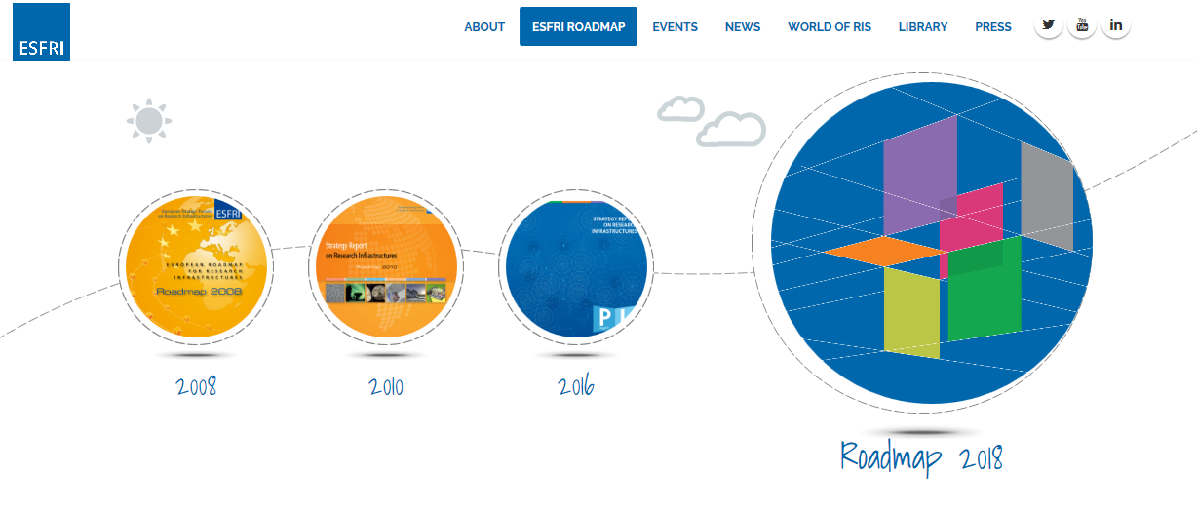
ESFRI ROAD MAP
ESFRI established, since 2006, an updated European Roadmap for Research Infrastructures (new and major upgrades, pan-European interest) for the following years. ESFRI stimulates the implementation of these facilities, and updates the roadmap as needed. ESFRI generally uses the FP programmes to leverage the scale-up of RIs

Slide 10
ESFRI ROAD MAP
ESFRI established, since 2006, an updated European Roadmap for Research Infrastructures (new and major upgrades, pan-European interest) for the following years. ESFRI stimulates the implementation of these facilities, and updates the roadmap as needed.
The ESFRI roadmap is an ongoing process. First published in 2006, with 35 projects…. The latest Roadmap, Roadmap 2018 includes 37 Landmarks and 18 ESFRI Projects.

Slide 11
How ESFRI works?
ESFRI is a self-regulated body, which operates openly and on a consensus basis. ESFRI Delegates are senior science-policy officials or equivalents, who represent ministers responsible for research in their country.
ESFRI organises open calls for proposals, selects proposals based on strict eligibility criteria and reviews them in a clear and transparent manner through independent, international peer review. Thus ESFRI contribute to a balance within the ERA between the bottom-up and top-down design of RI.
ESFRI Analysis is based on a double approach:
the evaluation of the scientific case,
the assessment of implementation

Slide 12
CONTENTS:
What is an European Research Infrastructure
Organisation of the EU Research Infrastructures and the ESFRI ROADMAP
ESFRI Landmarks and RI Projects
ERIC a one way to develop the ESFRI Landmark

Slide 13
ESFRI Road Map: ESFRI Projects and ESFRI Landmarks
ESFRI Projects: are RIs in their Preparation Phase which have been selected for the excellence of their scientific case and for their maturity, according to a sound expectation that the Project will enter the Implementation Phase within the ten-year term.
ESFRI Landmark: are RIs that were implemented, or reached an advanced Implementation Phase, under the Roadmap. The Landmarks can be already delivering science services and granting user access, or can be in advanced stage of construction with a clear schedule for the start of the Operation Phase.

Slide 14
ESFRI Projects and ESFRI Landmarks in Health & Food
ESFRI Projects:
AnaEE: Infrastructure for Analysis and Experimentation on Ecosystems
EMPHASIS: European Infrastructure for Multi-scale Plant Phenomics and Simulation
EU-IBISBA: European Industrial Biotechnology Innovation and Synthetic Biology Accelerator
ISBE: Infrastructure for System Biology Europe
METROFOOD-RI: Infrastructure for Promoting Metrology in Food and Nutrition
MIRRI: Microbial Resource Research Infrastructure

Slide 15
ESFRI Projects and ESFRI Landmarks in Health & Food
ESFRI Landmarks:
BBMRI-ERIC: Biobanking and BioMolecular Resources Research Infrastructure.
EATRIS-ERIC: European Advanced Translational Research Infrastructure in Medicine.
ECRIN-ERIC: European Clinical Research Infrastructure Network.
ELIXIR: A distributed infrastructure for life-science information
EMBRC: European Marine Biological Resource Centre
ERINHA: European Research Infrastructure on Highly Pathogenic Agents
EU OPENSCREEN-ERIC: European Infrastructure of Open Screening Platforms for Chemical Biology.
EUROBIOIMAGING: European Research Infrastructure for Imaging Technologies in Biological and Biomedical Sciences
INFRAFRONTIER: Generation, phenotyping, archiving and distribution of mouse disease models
INSTRUCT-ERIC: Integrated Structural Biology Infrastructure

Slide 16
CONTENTS:
What is an European Research Infrastructure
Organisation of the EU Research Infrastructures and the ESFRI ROADMAP
ESFRI Landmarks and RI Projects
ERIC, the often way to develop towards the ESFRI Landmark

Slide 17
ERIC, the most common way to become an ESFRI Landmark
ERIC: European Research Infrastructure Consortium, is a legal instrument, based in the EU Regulation 723/2009, to provide a legal framework for Pan-European Research Infrastructures.
ERIC is a body with its own legal personality, recognised by al EU Member States. Its main features are:
- Members of the ERIC are the countries, and not organizations,
- Contribute to execute EU research Activities,
- Offer scientific and/or technological value added at EU Level
- Open to other EU Members and H2020 Associated Countries
- Facilitate and promote the mobility of researchers and knowledge through the ERA
- Disseminate and optimise the use of the results and outcomes of the R&I activities.
In order to get the ERIC Status, there is process for its application.

Slide 18
ERIC, the most common way to become an ESFRI Landmark
In order to get the ERIC Status, there is process for its application, that includes:
ERIC Application
Statutes Proposal, including members, governing bodies, duration, main principles, etc
Scientific and Technical Description, including also the financial plan (5 years)
Declaration of the Hosting Country for VAT Exoneration and other Fiscal Benefits
It is re- evaluated every five years

